Slide 1
LESSON 1

Slide 2
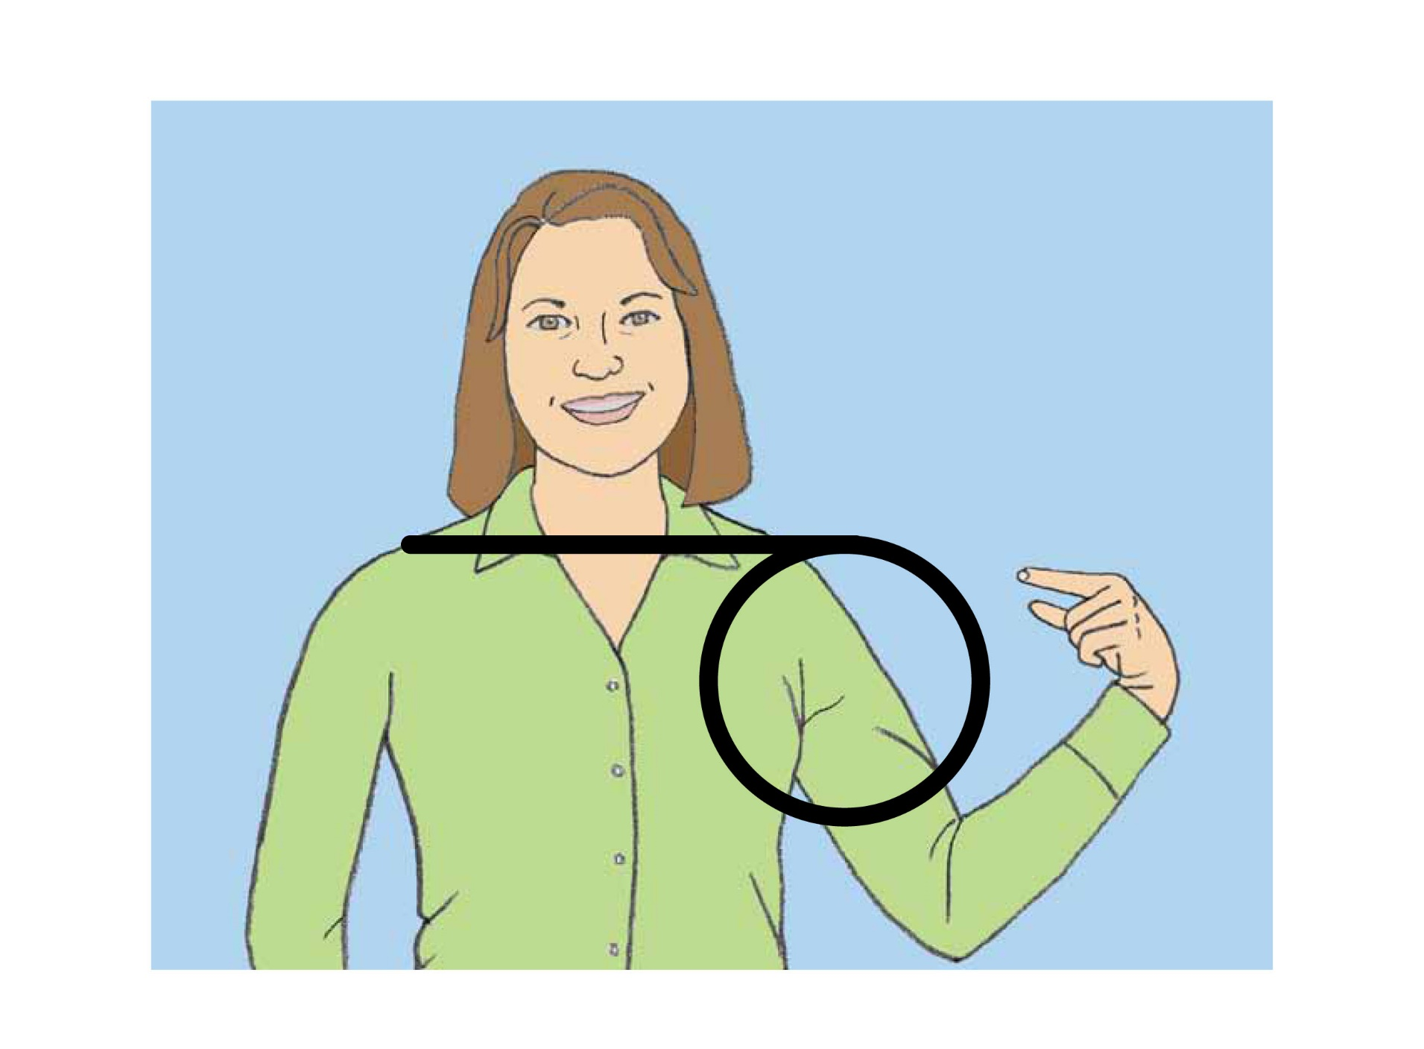
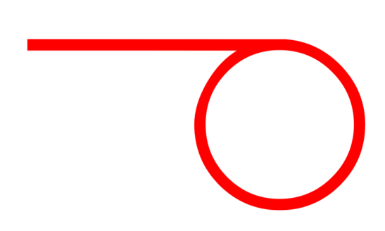
Me

Slide 3

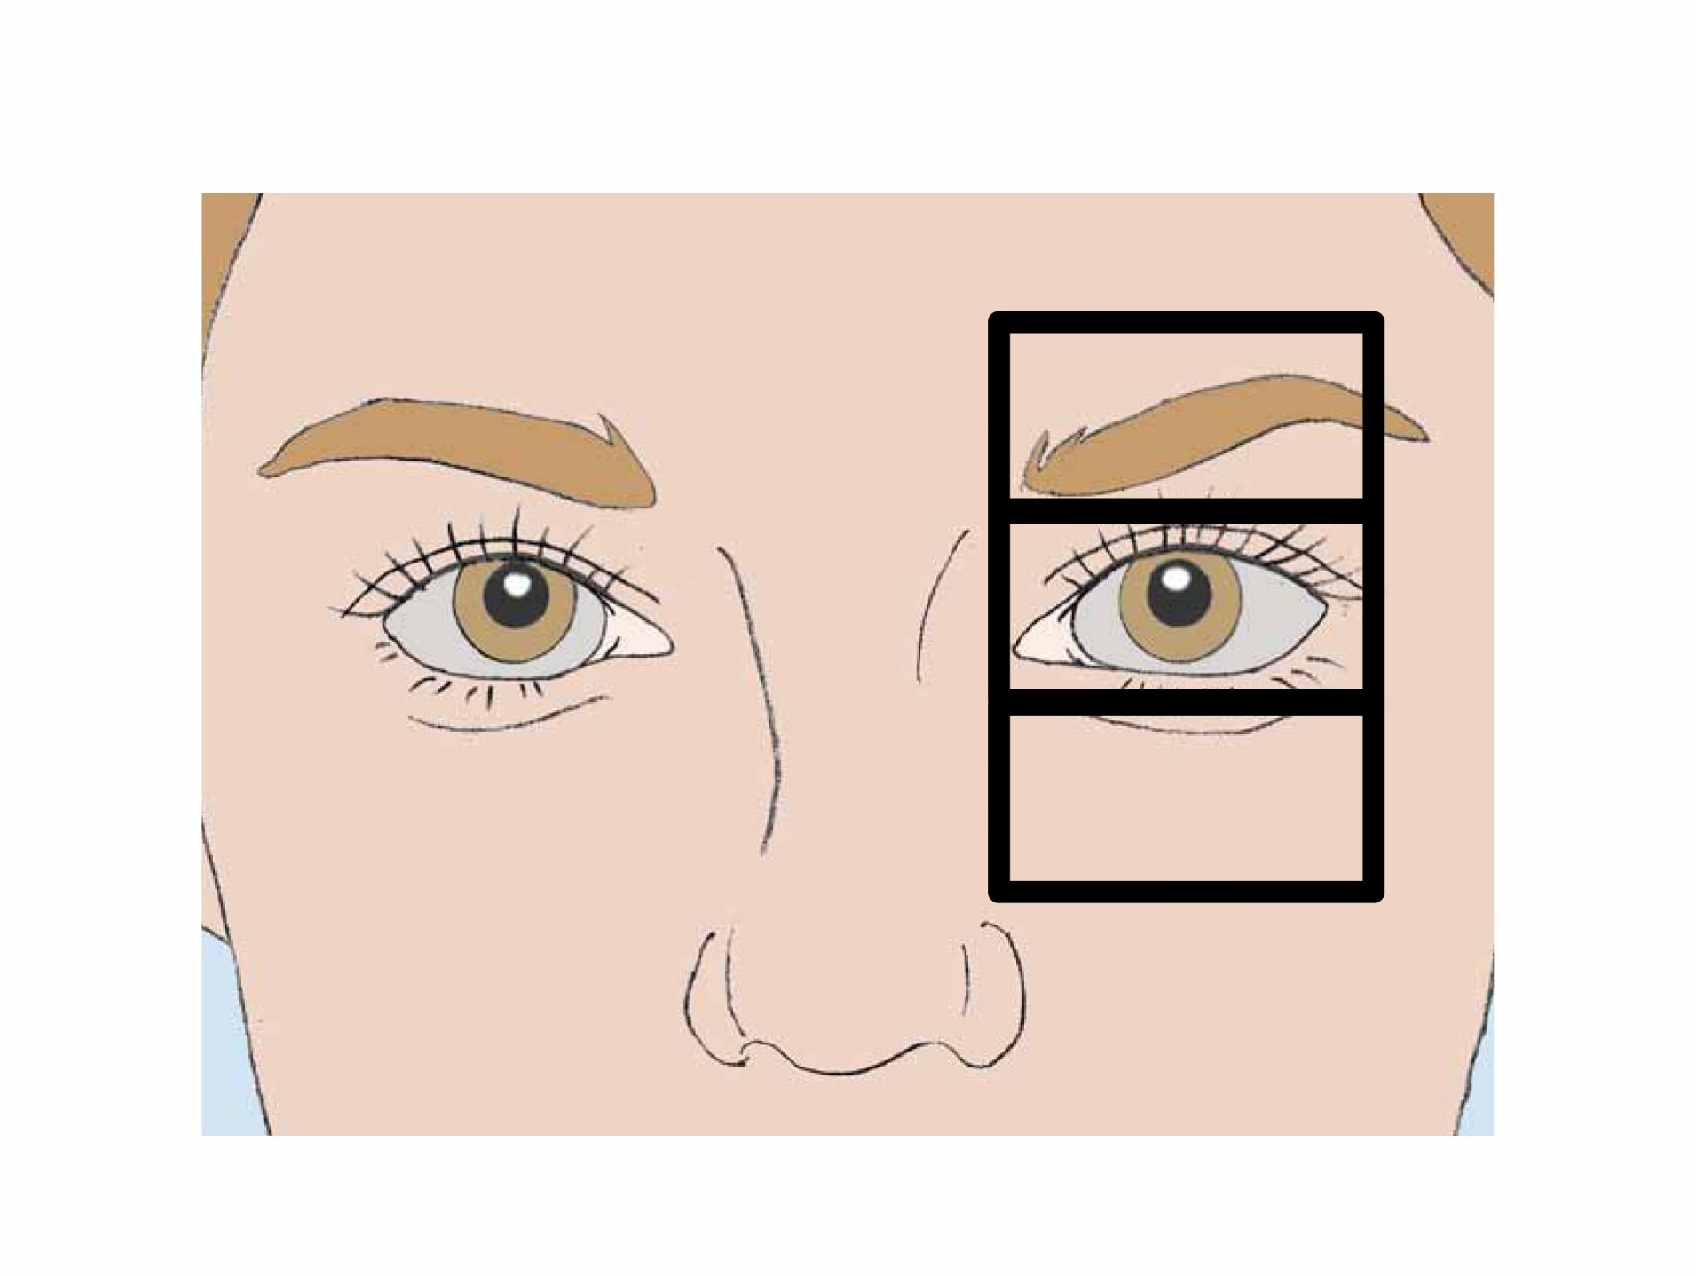
Eye
See

Slide 4
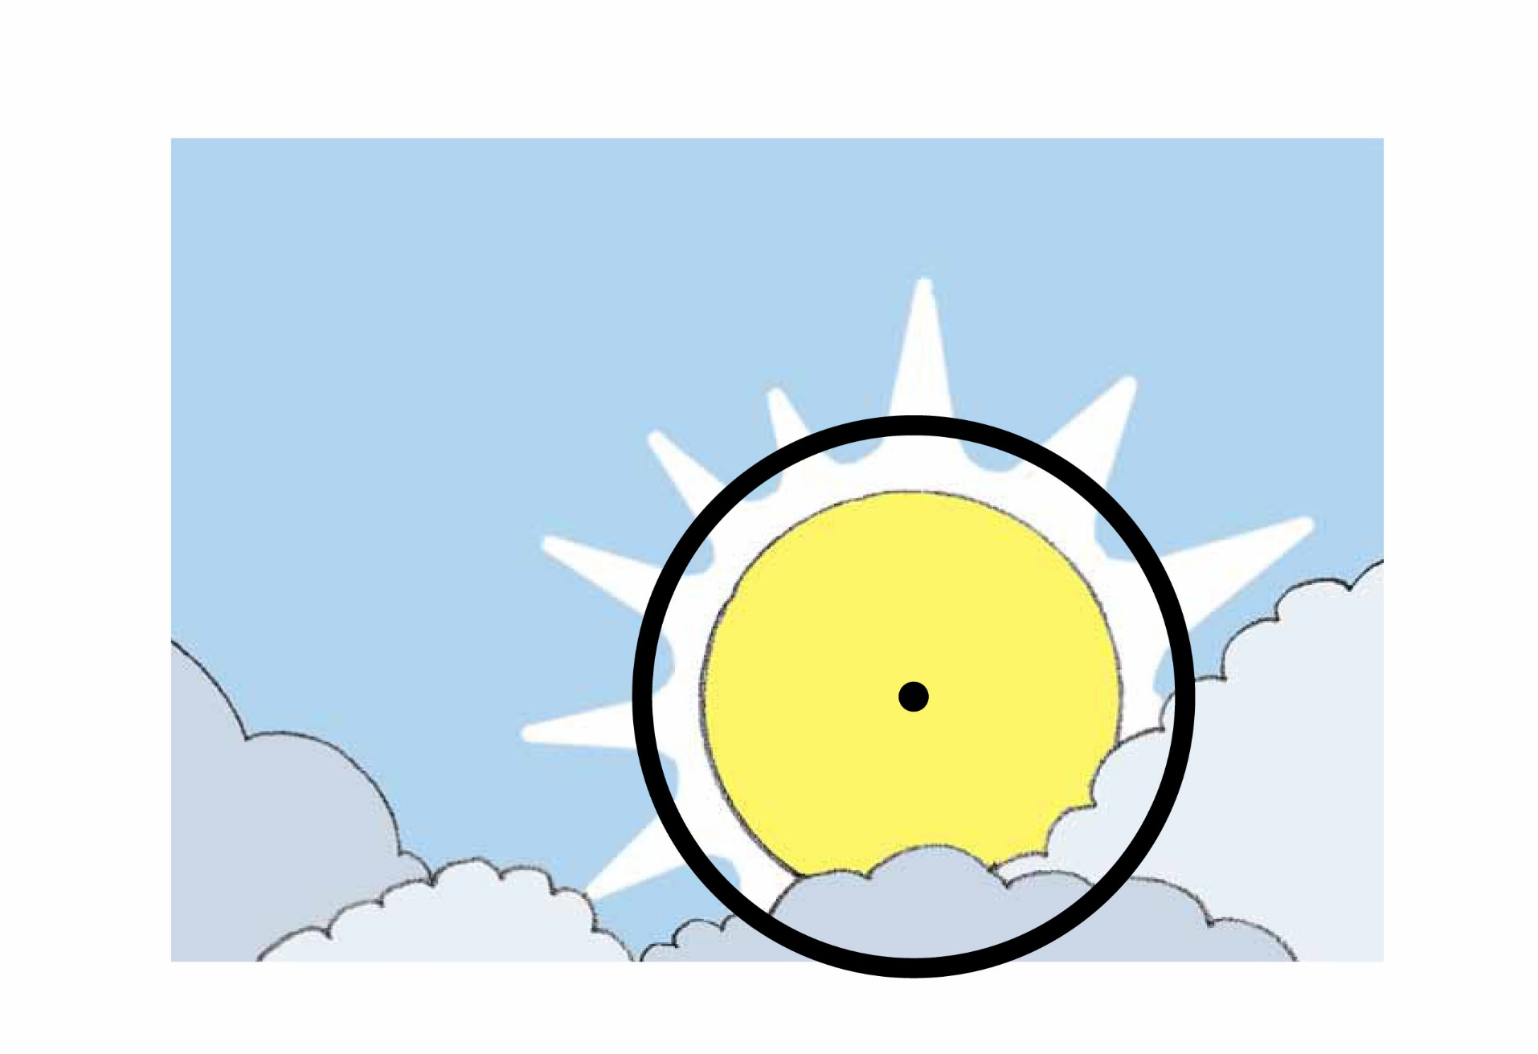

Sun
Day
Light

Slide 5


Moon
Night

Slide 6
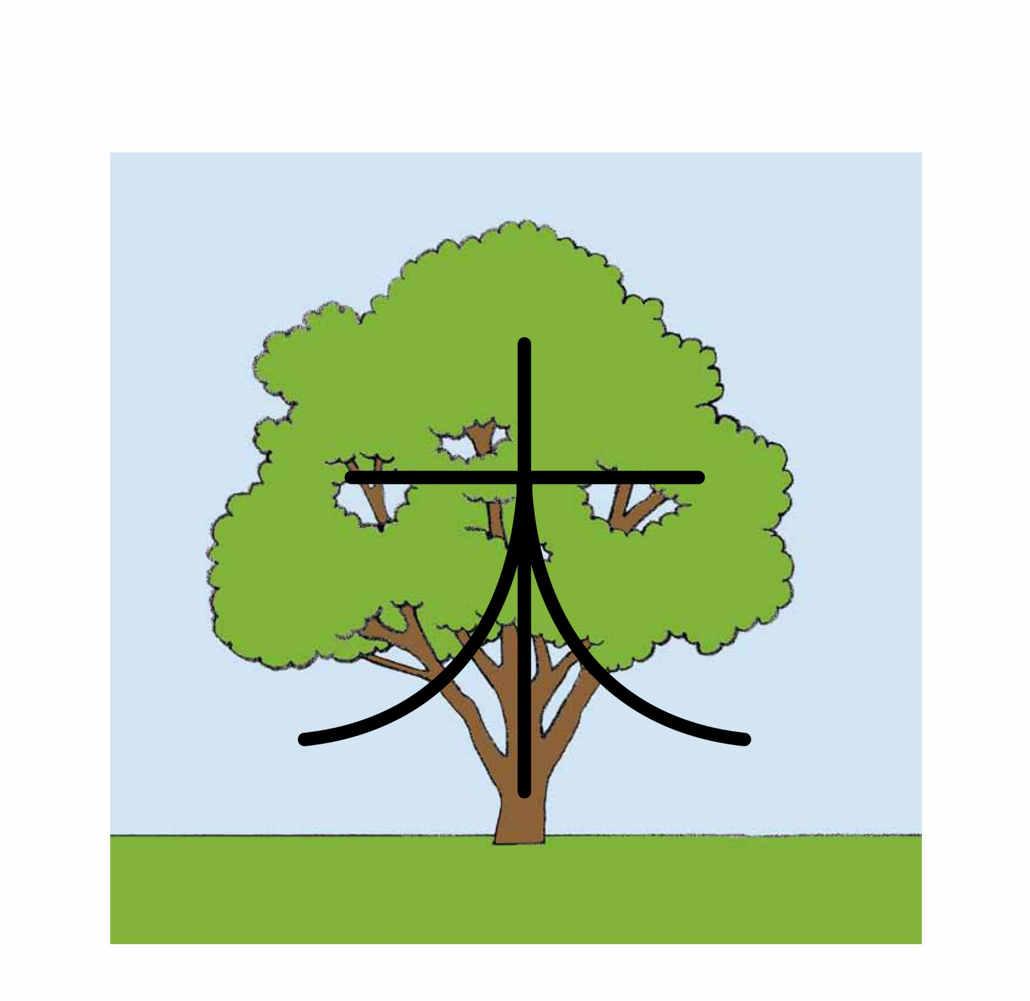
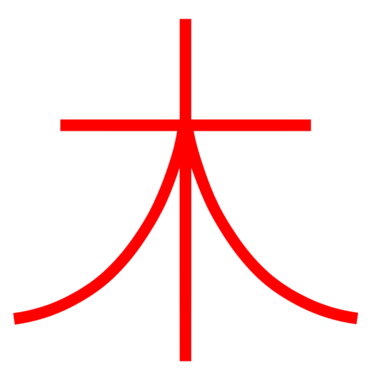
Tree
Plant

Slide 7
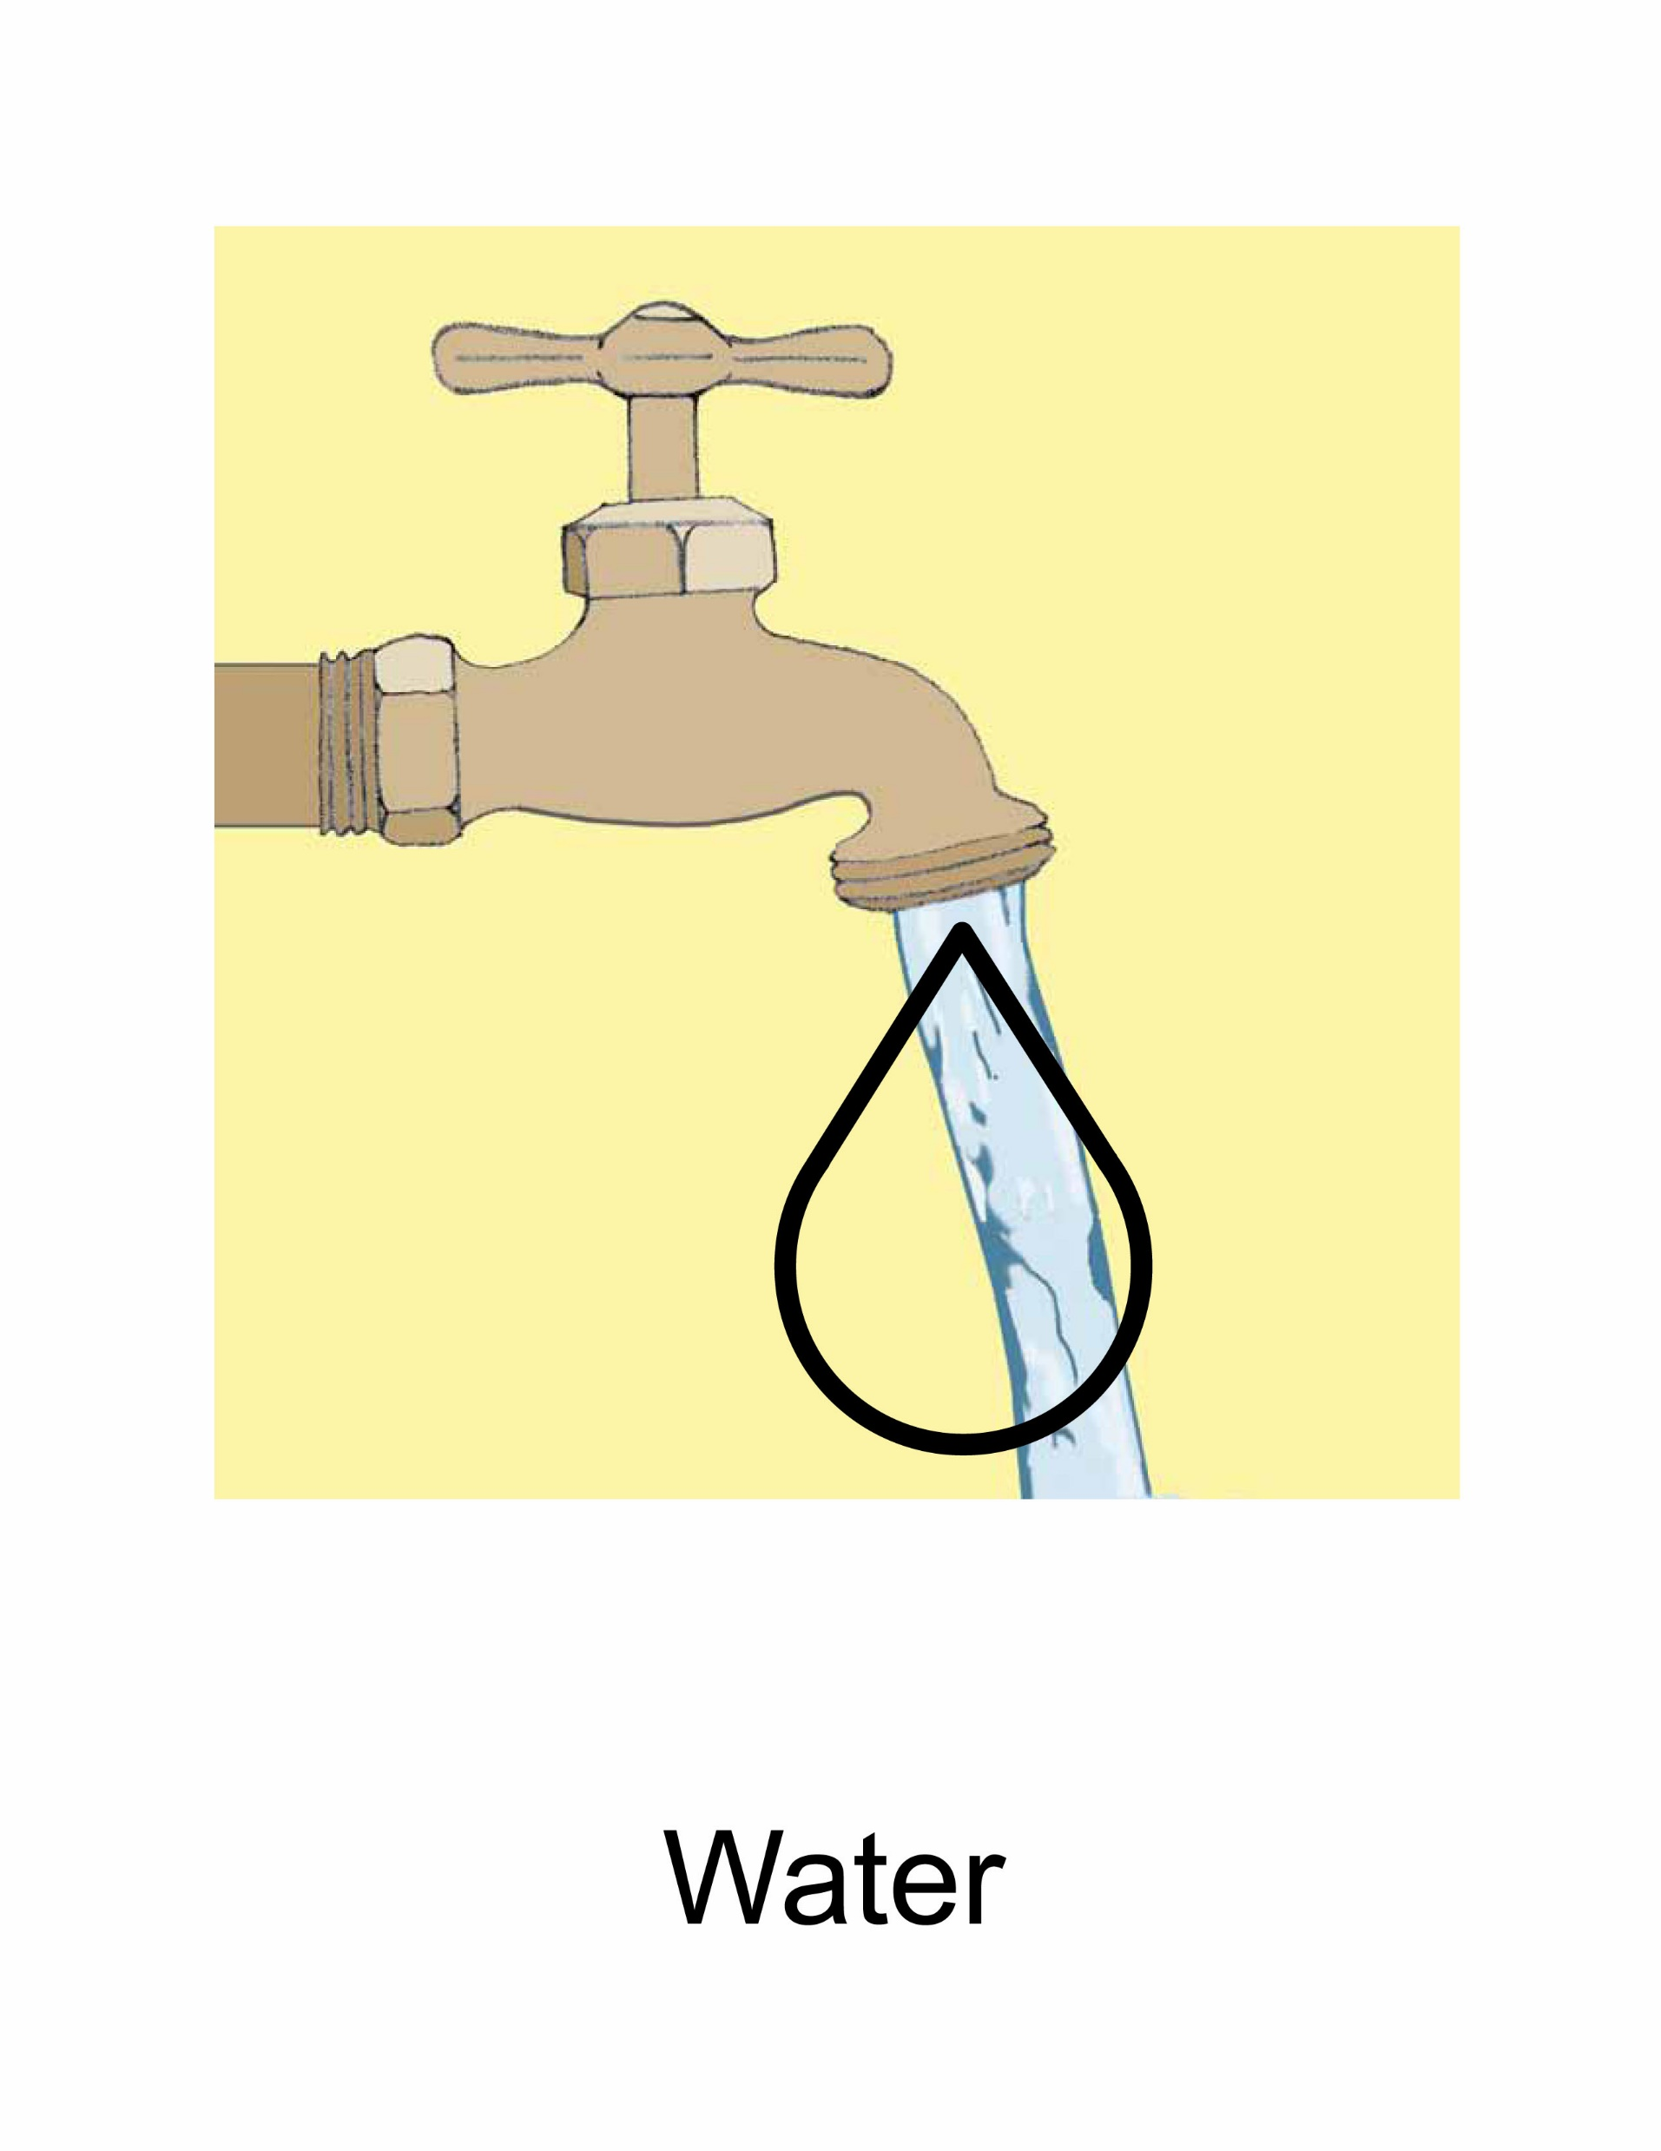

Water

Slide 8
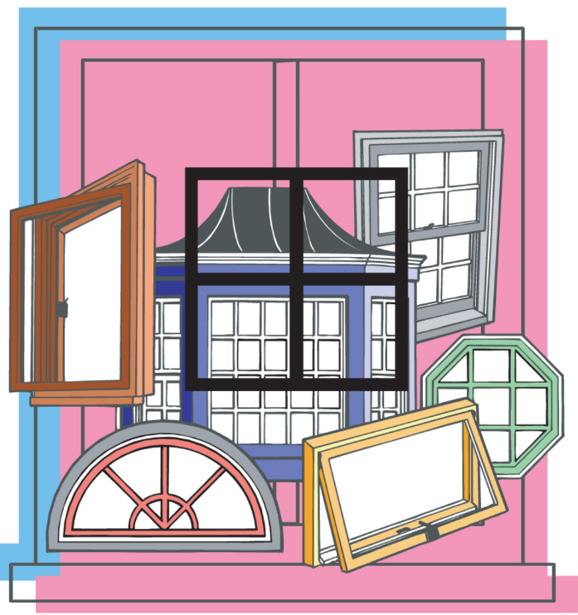

Window

Slide 9
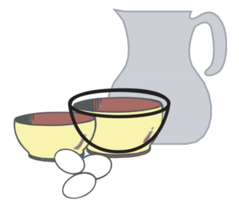
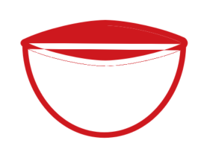
Bowl
Dish

Slide 10
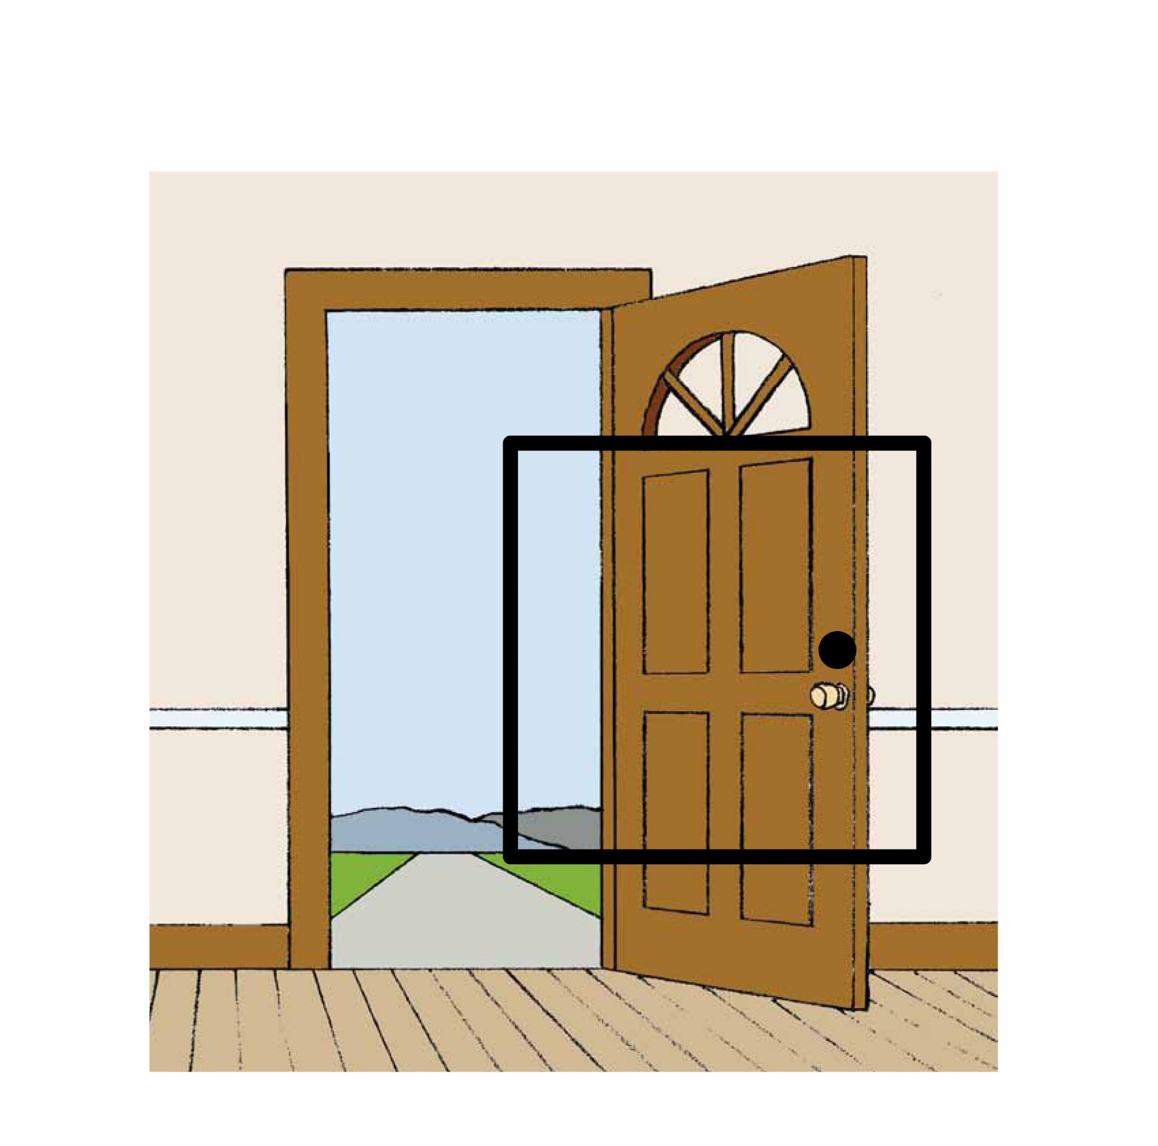

Door

Slide 11
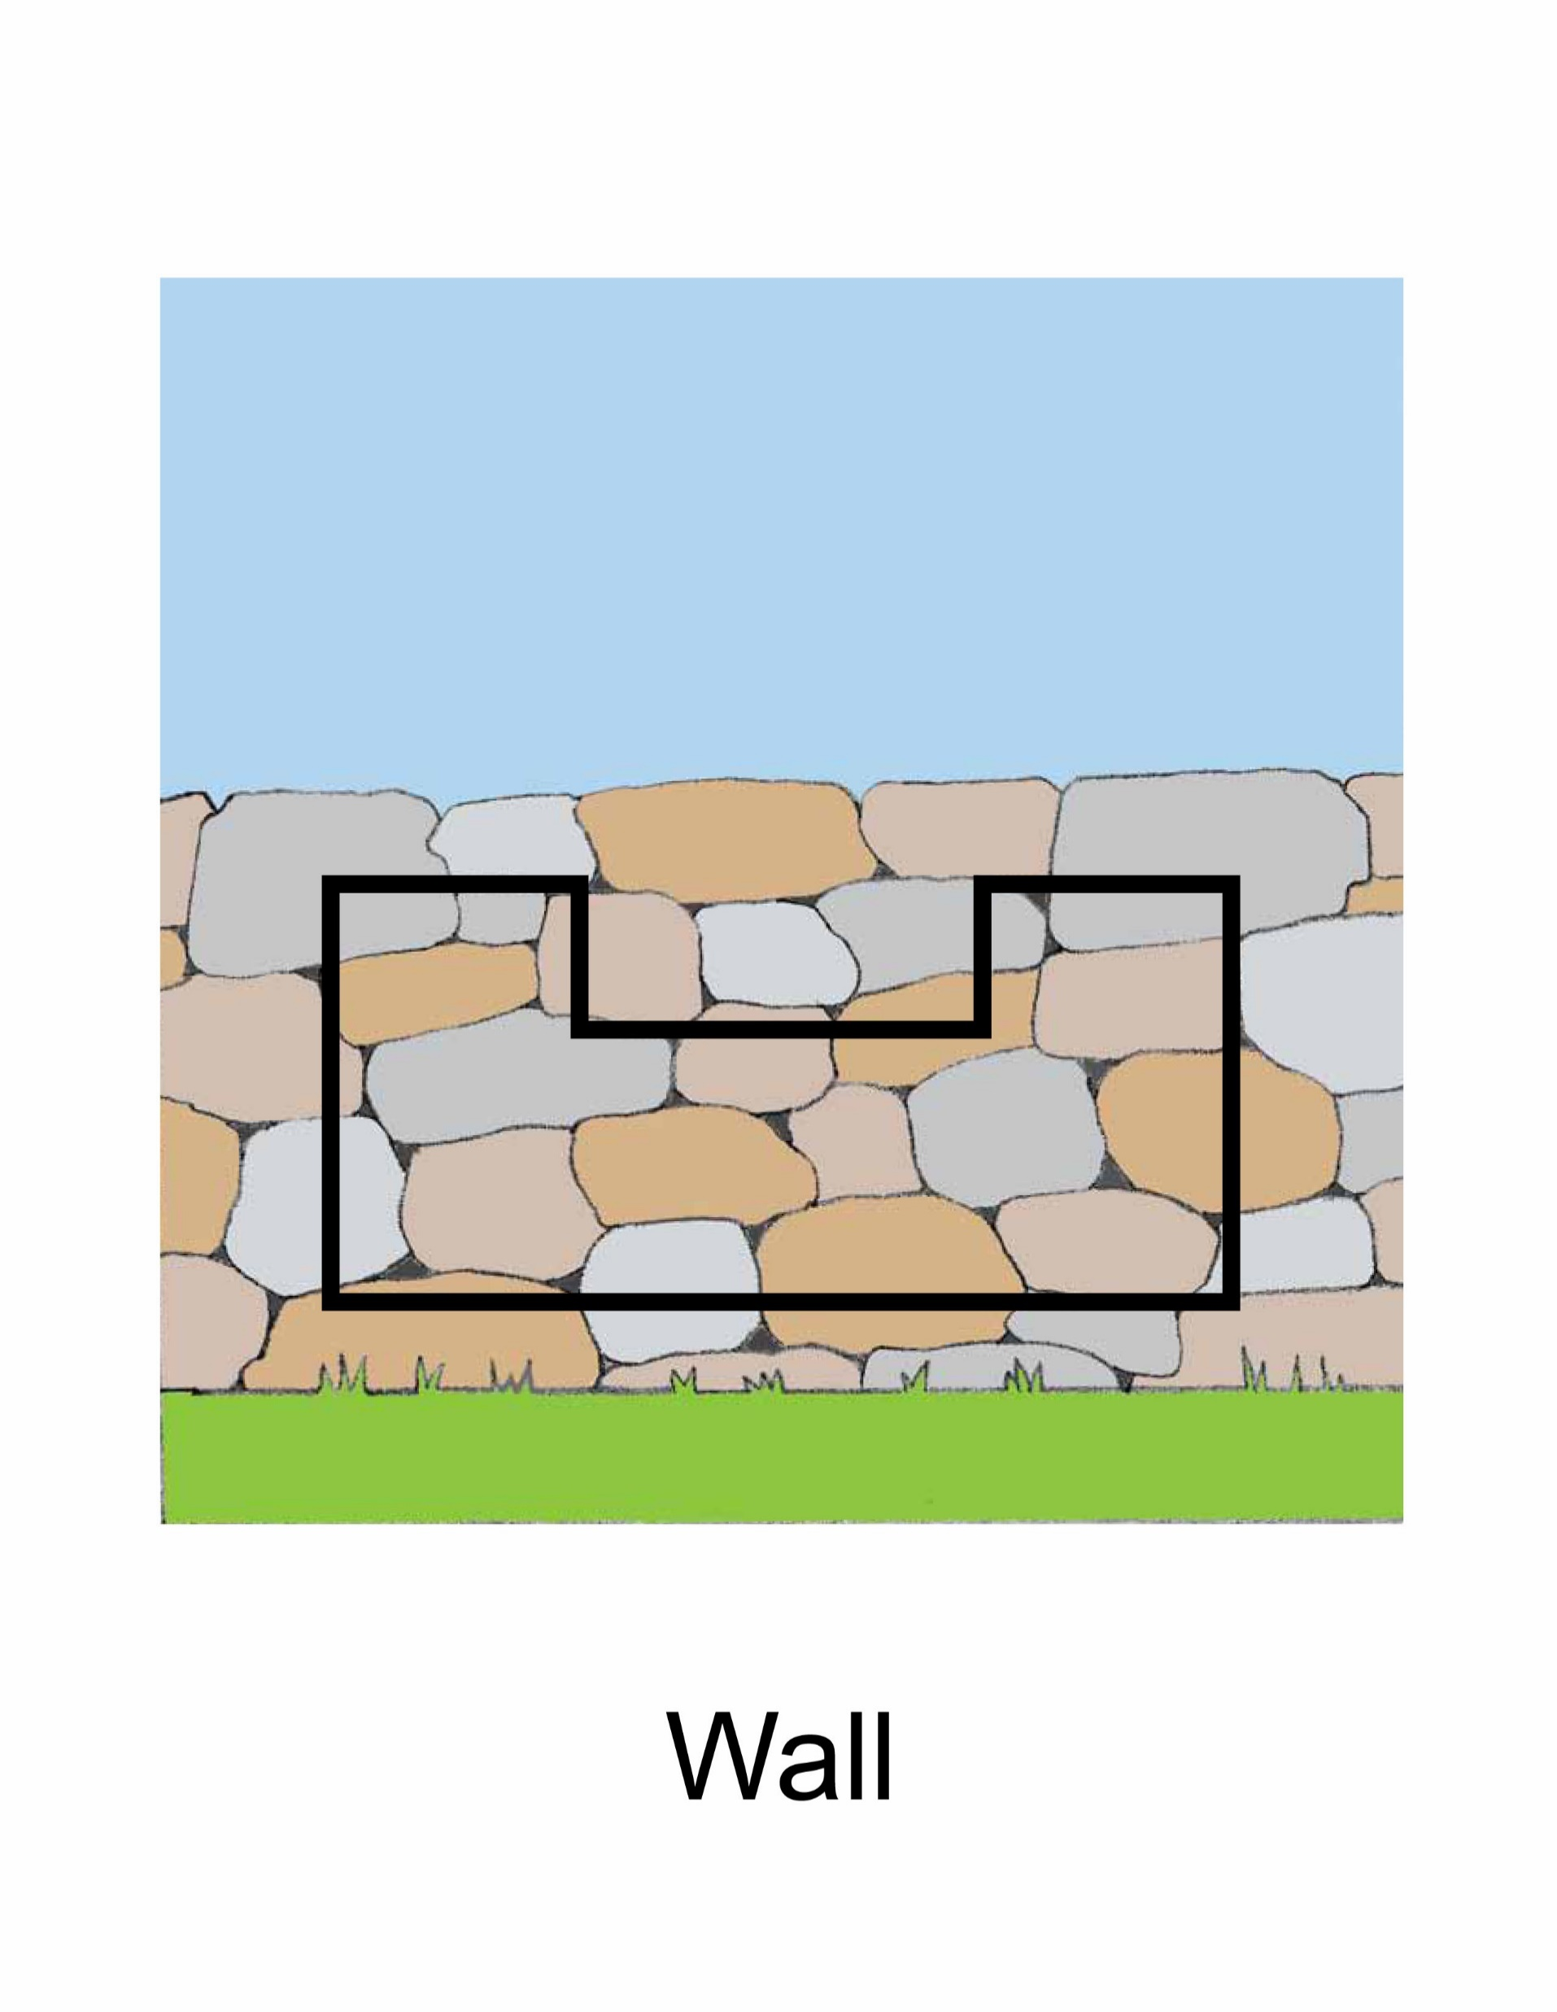

Wall

Slide 12

Notes:
I see the sun.

Slide 13

Notes:
I see the moon.

Slide 14

Notes:
I see the tree.

Slide 15

Notes:
I see water.

Slide 16

Notes:
I see the window

Slide 17
LESSON 2

Slide 18
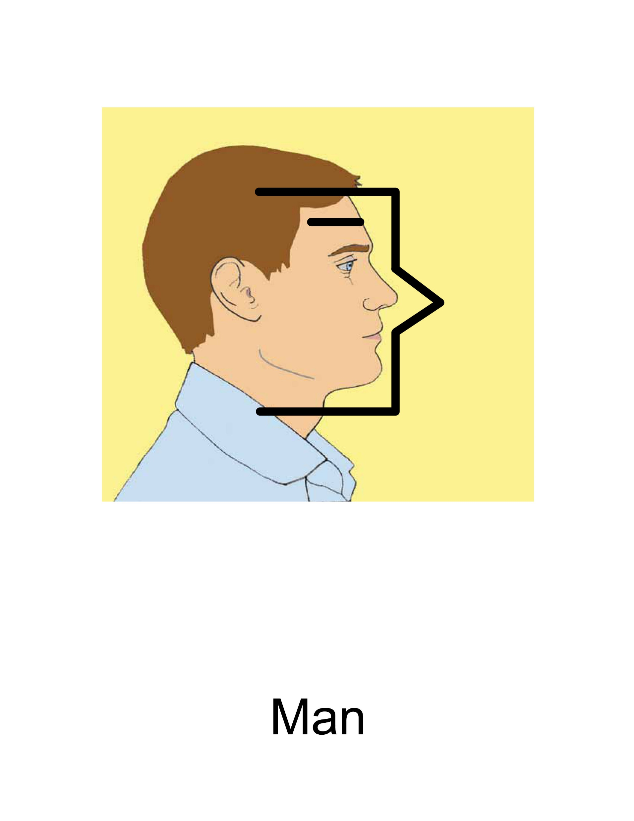

Man

Slide 19
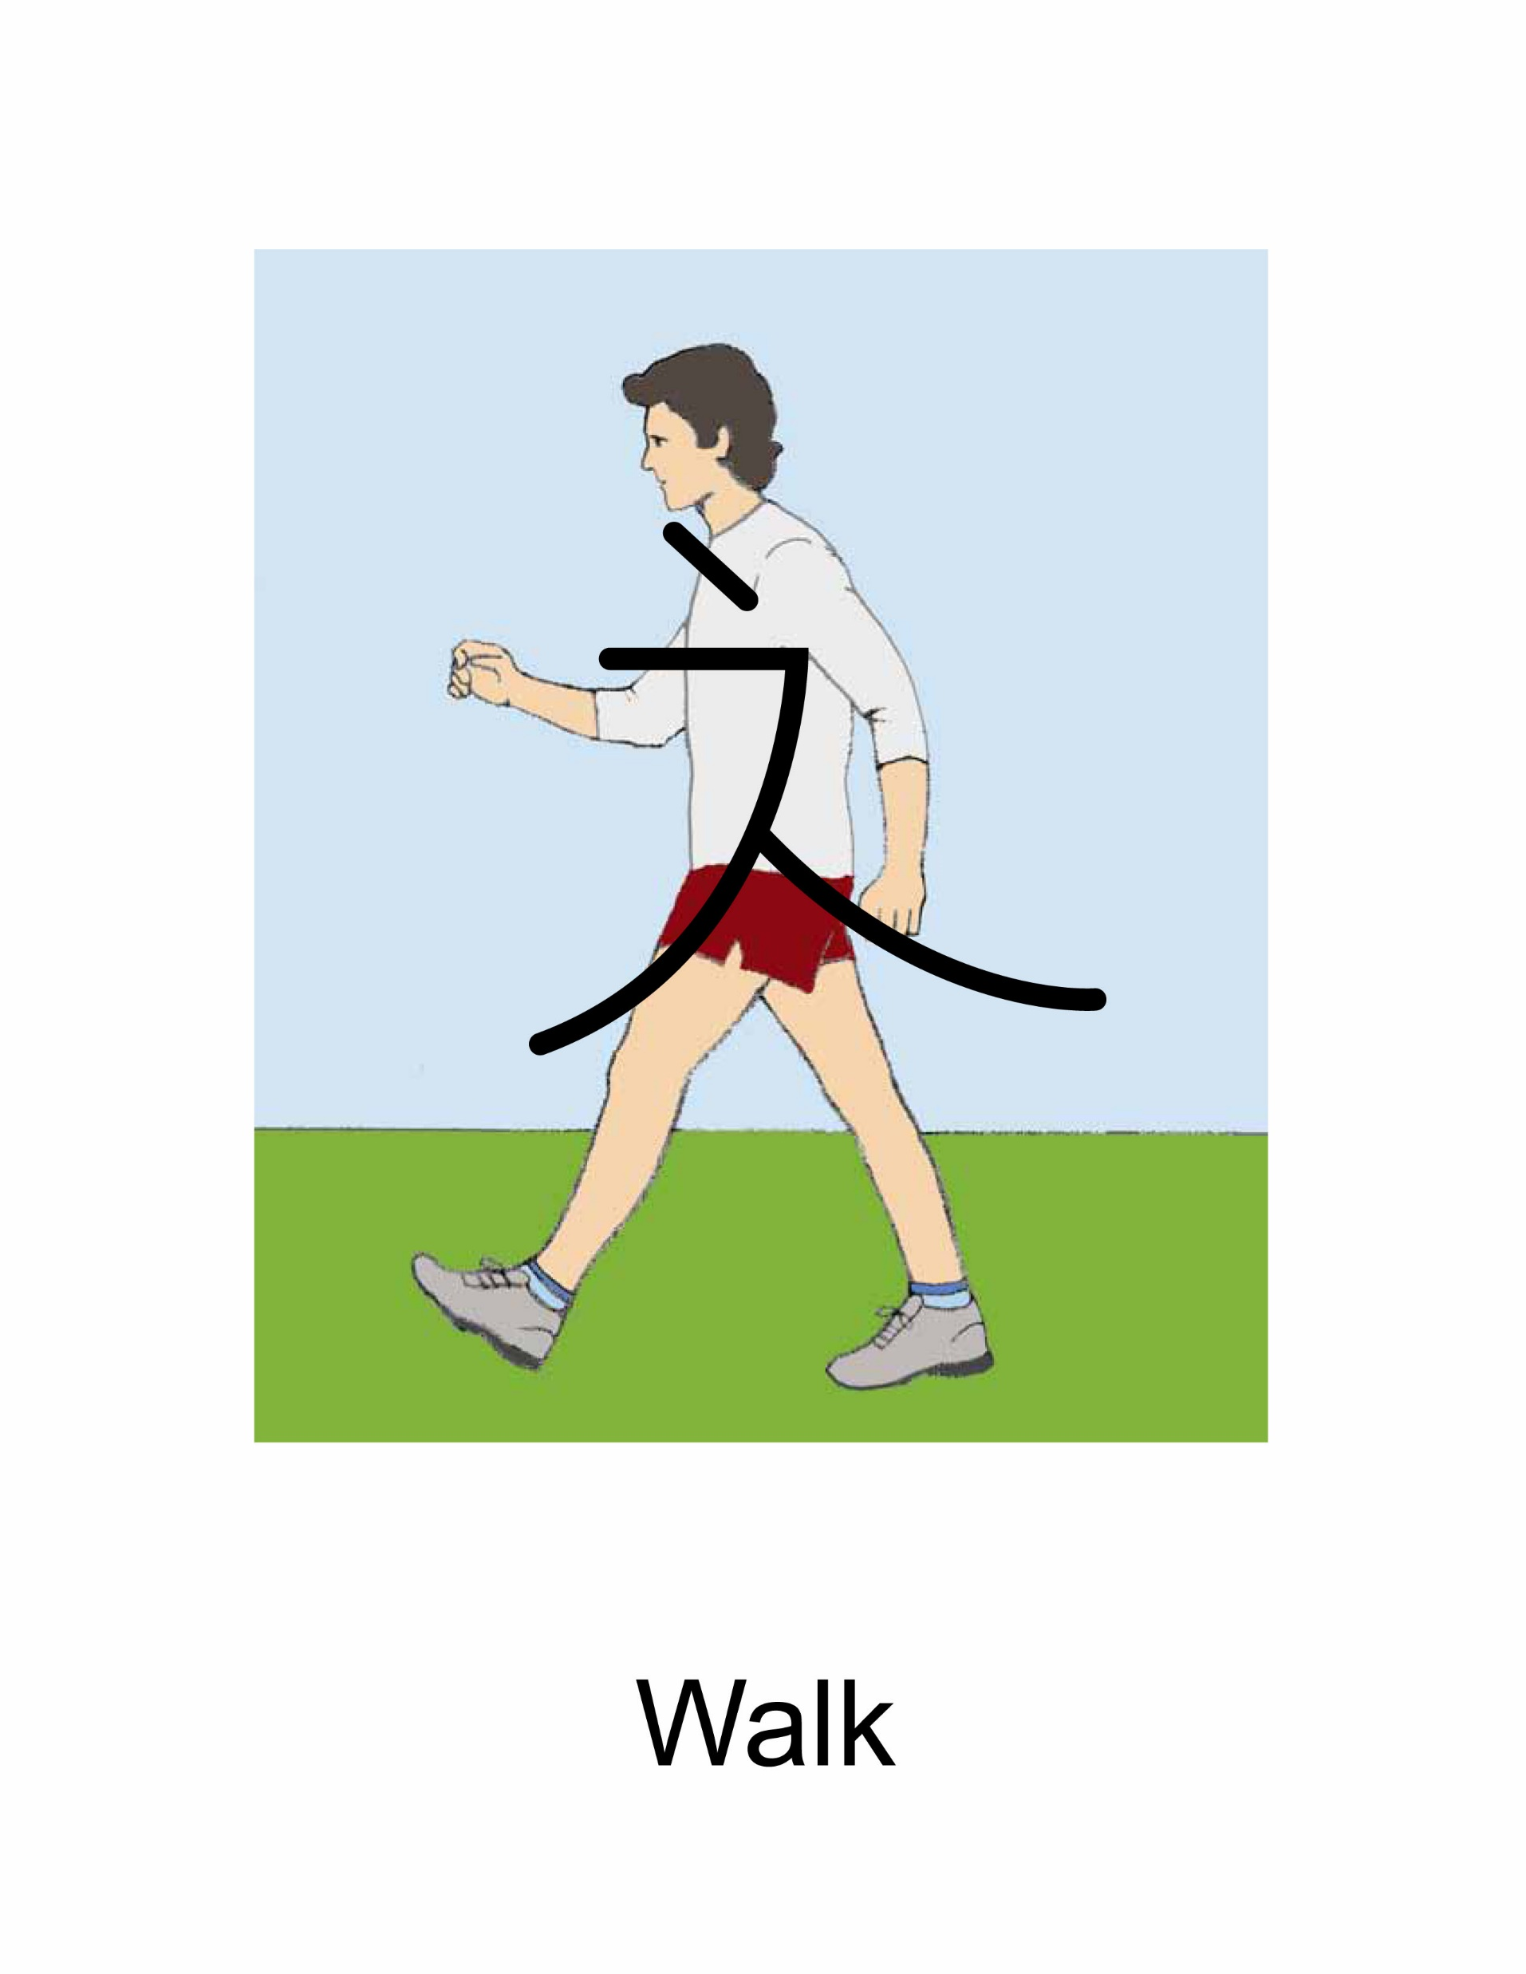
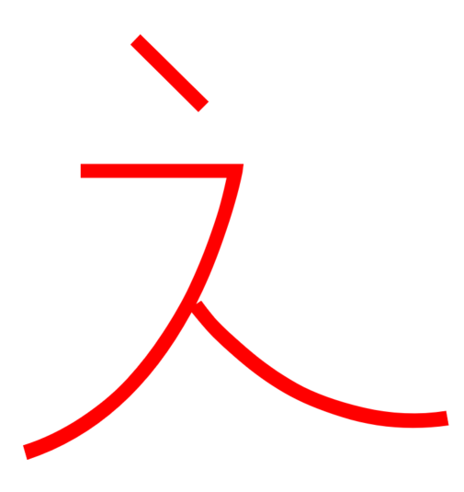
Walk

Slide 20
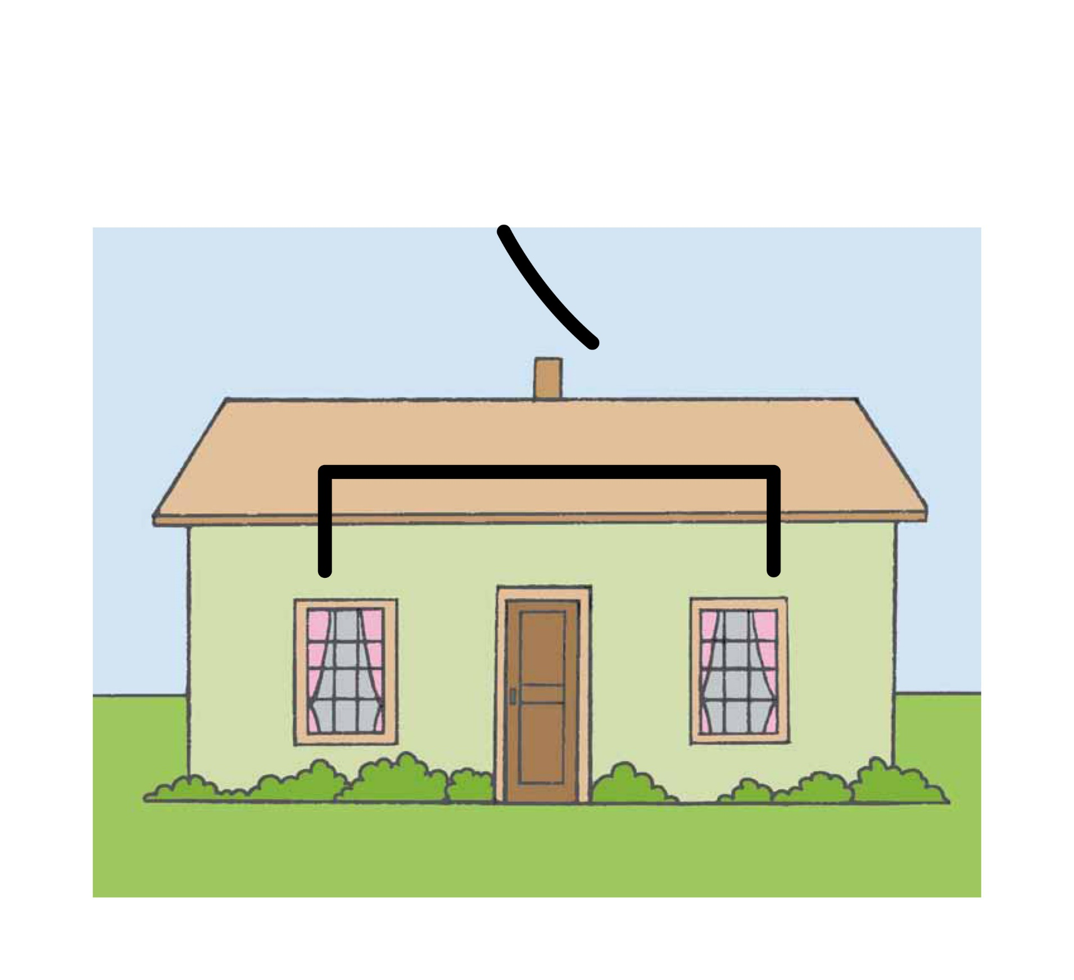
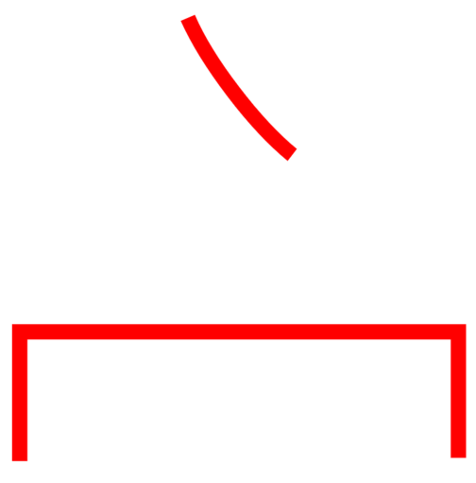
House

Slide 21
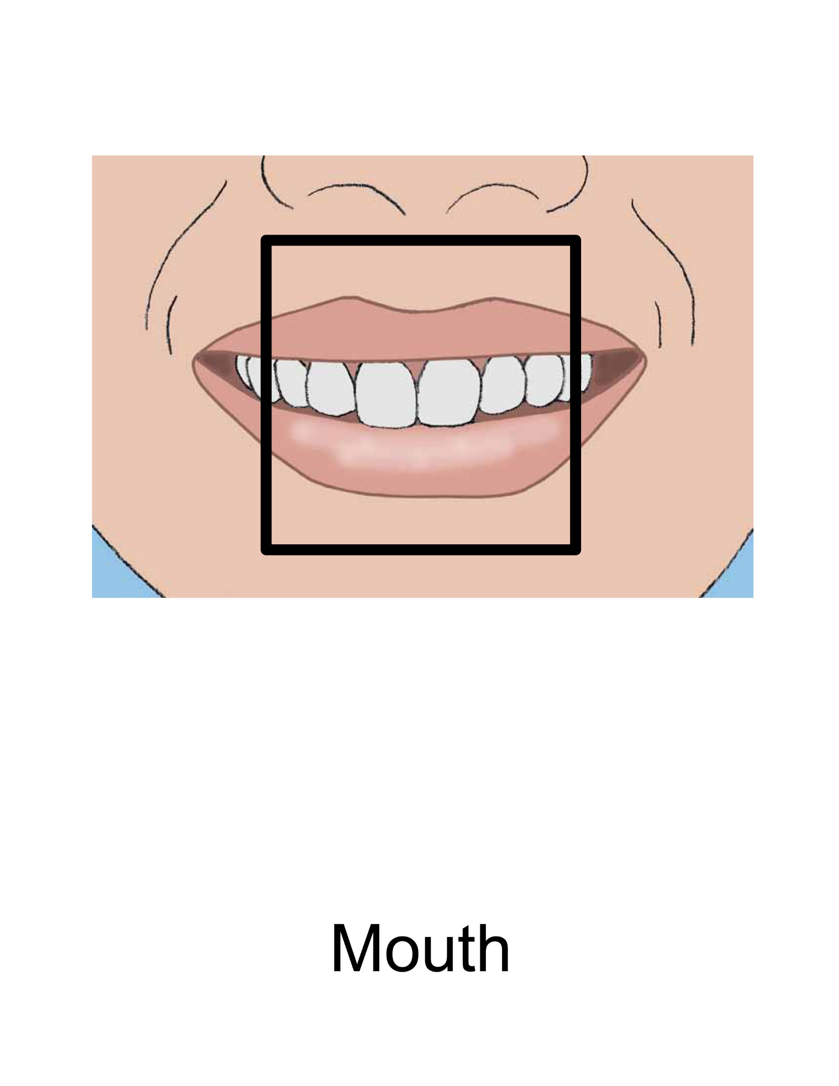

Mouth
Speak
Tell

Slide 22
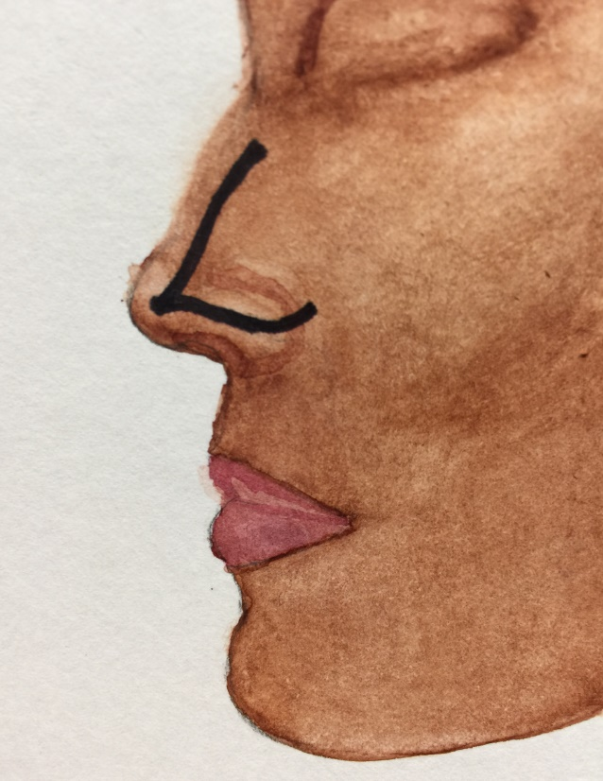
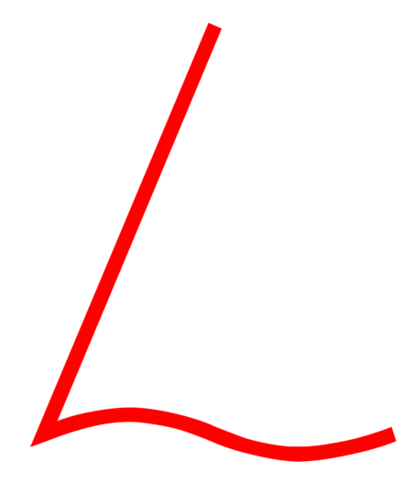
Nose
Smell

Slide 23
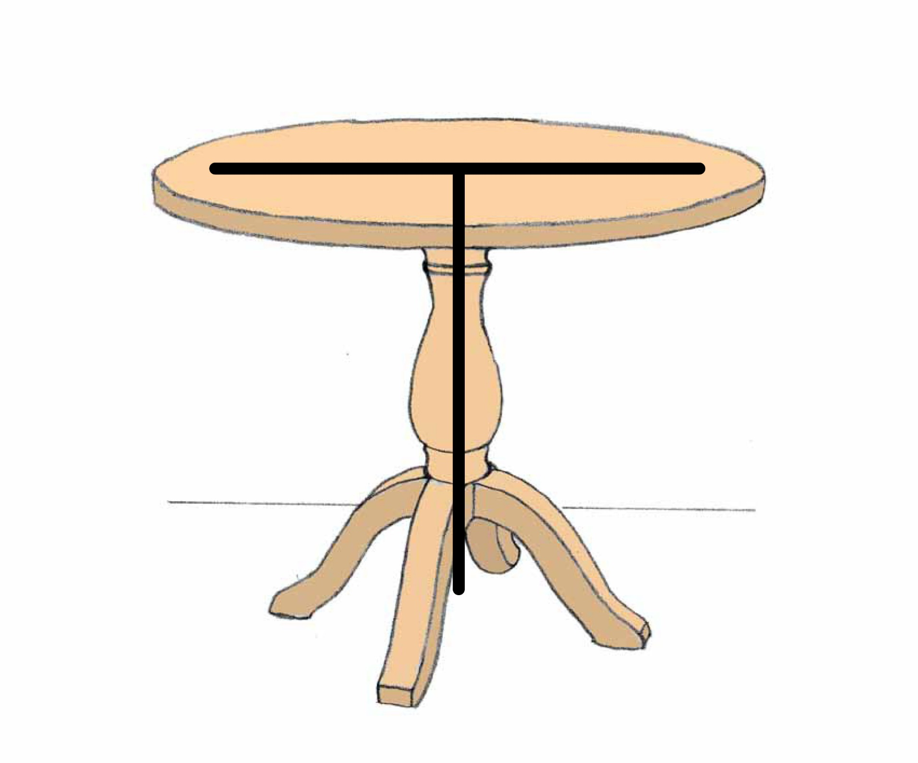

Table

Slide 24

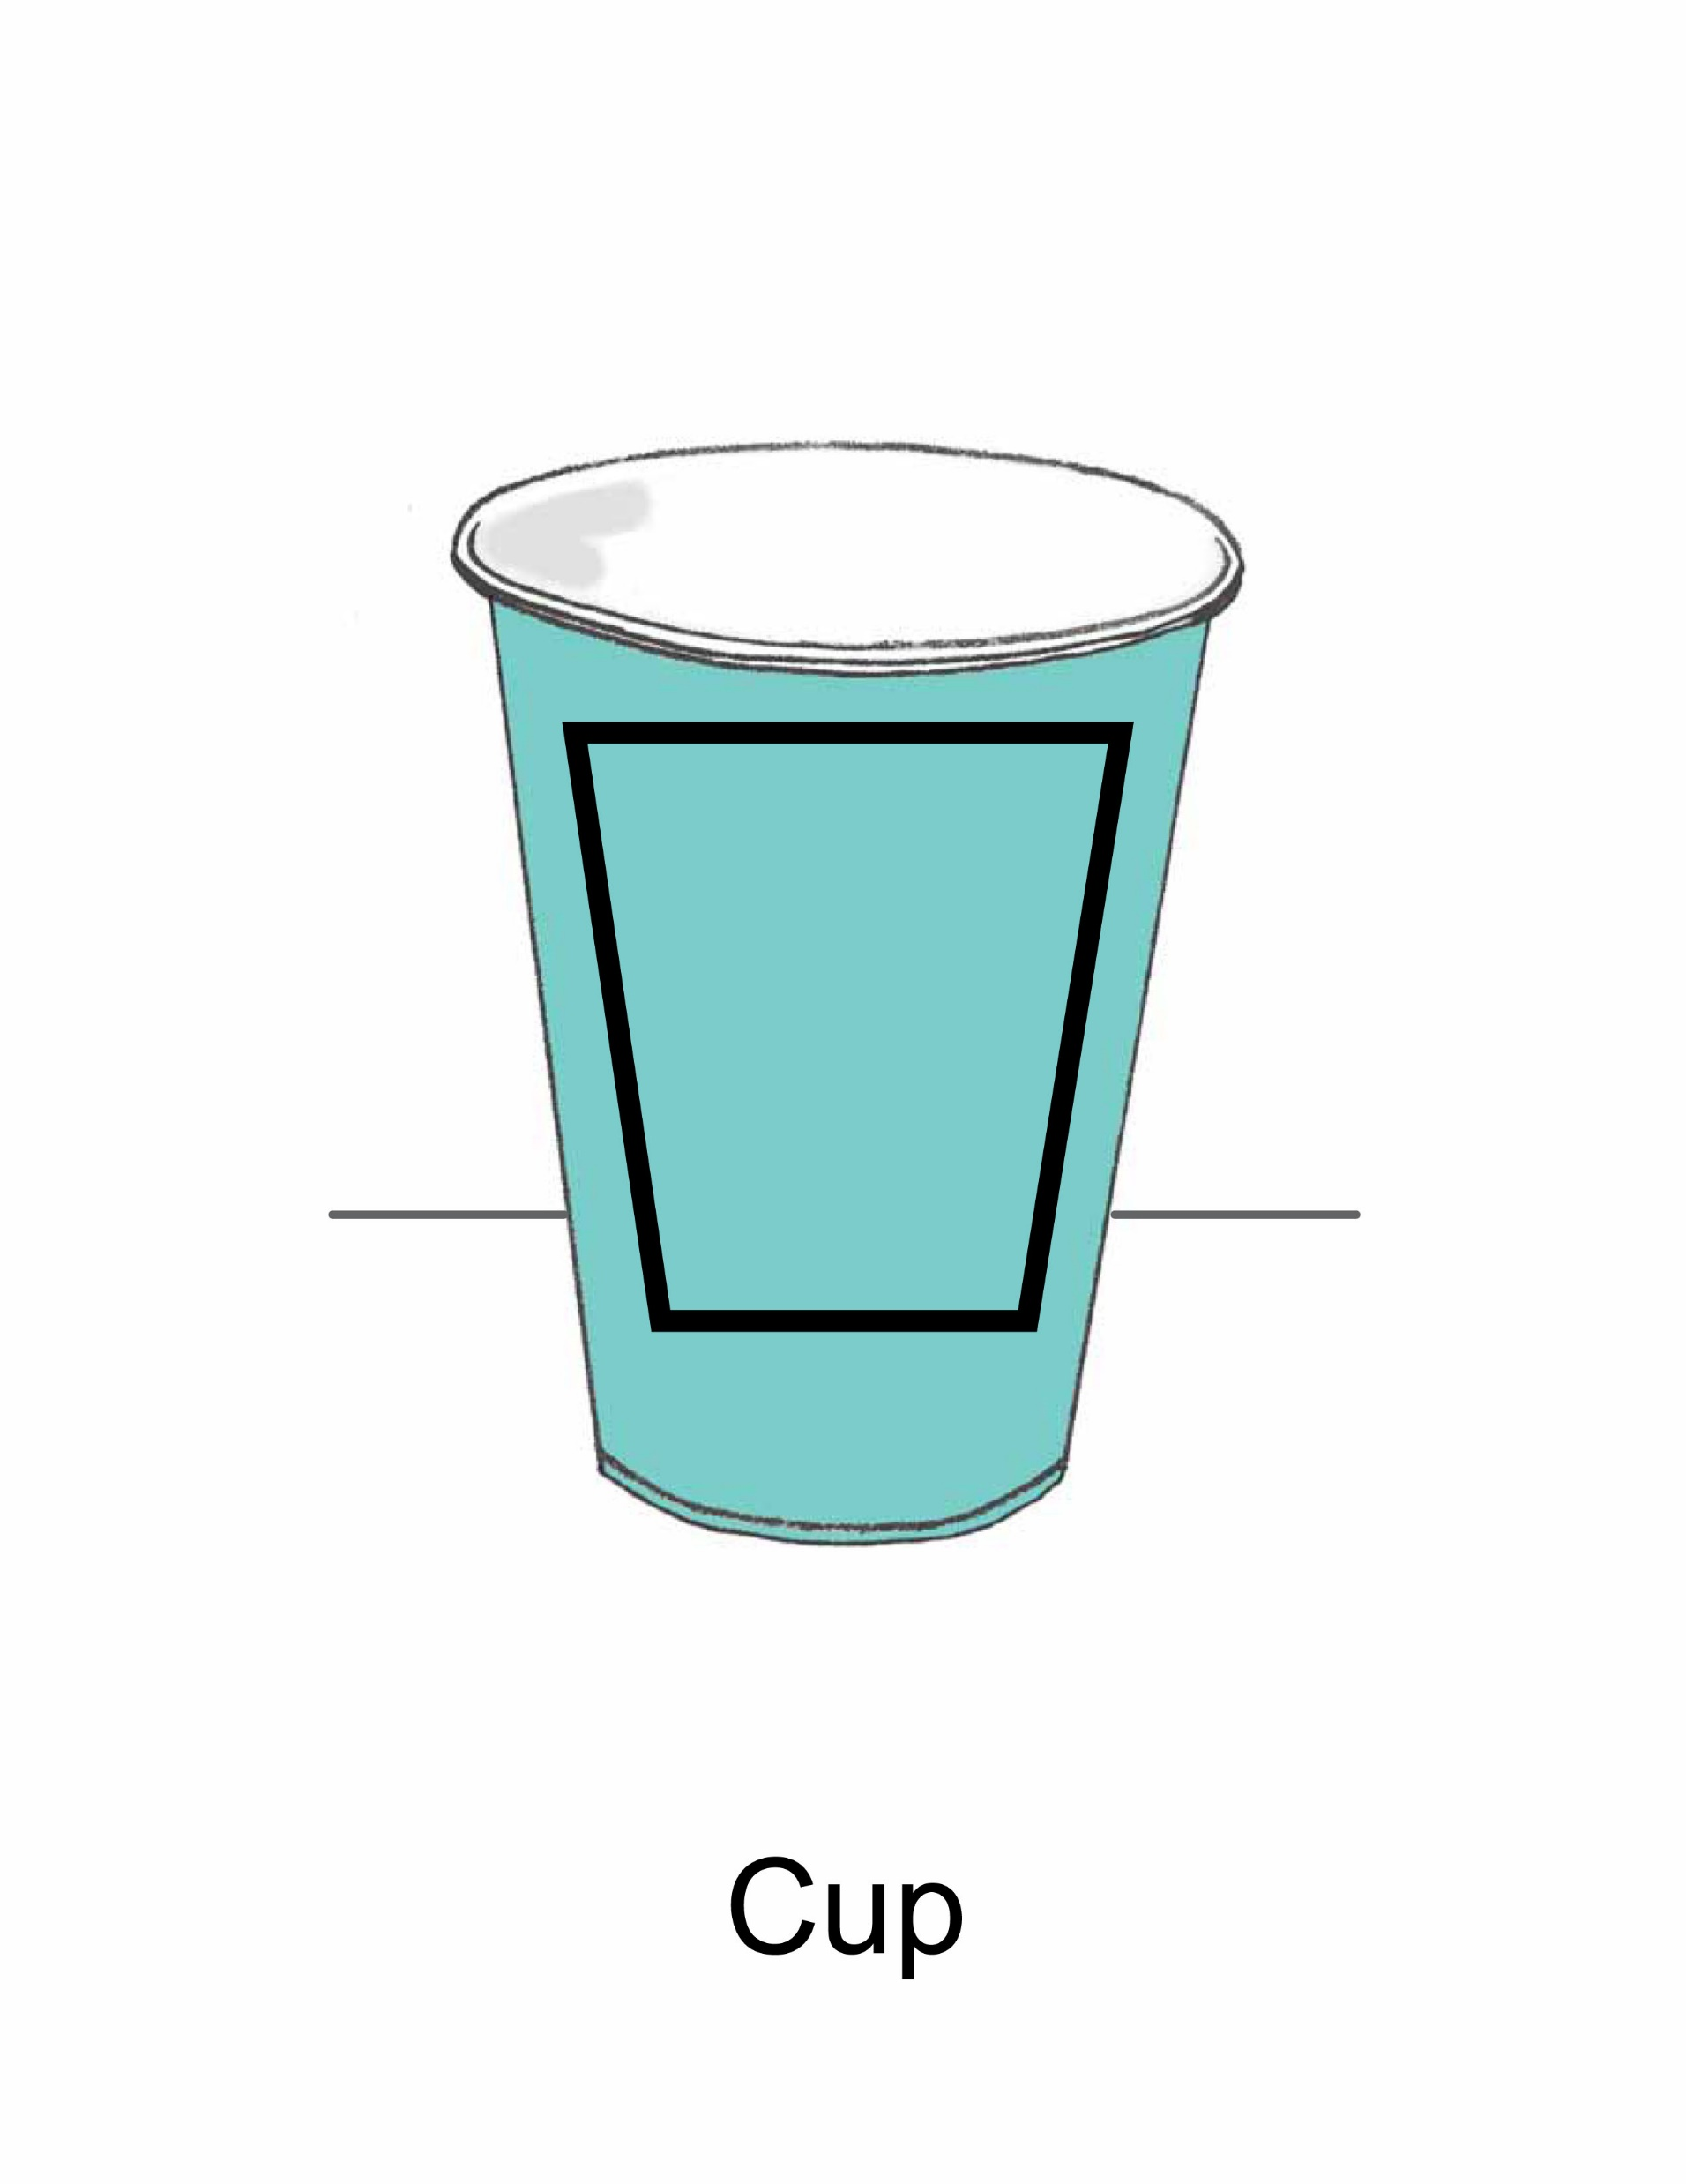
Cup
Drink

Slide 25
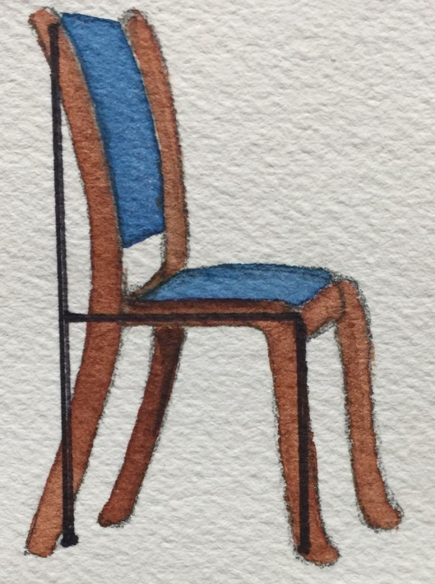

Chair
Sit

Slide 26
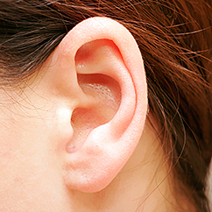

Ear
Hear

Slide 27
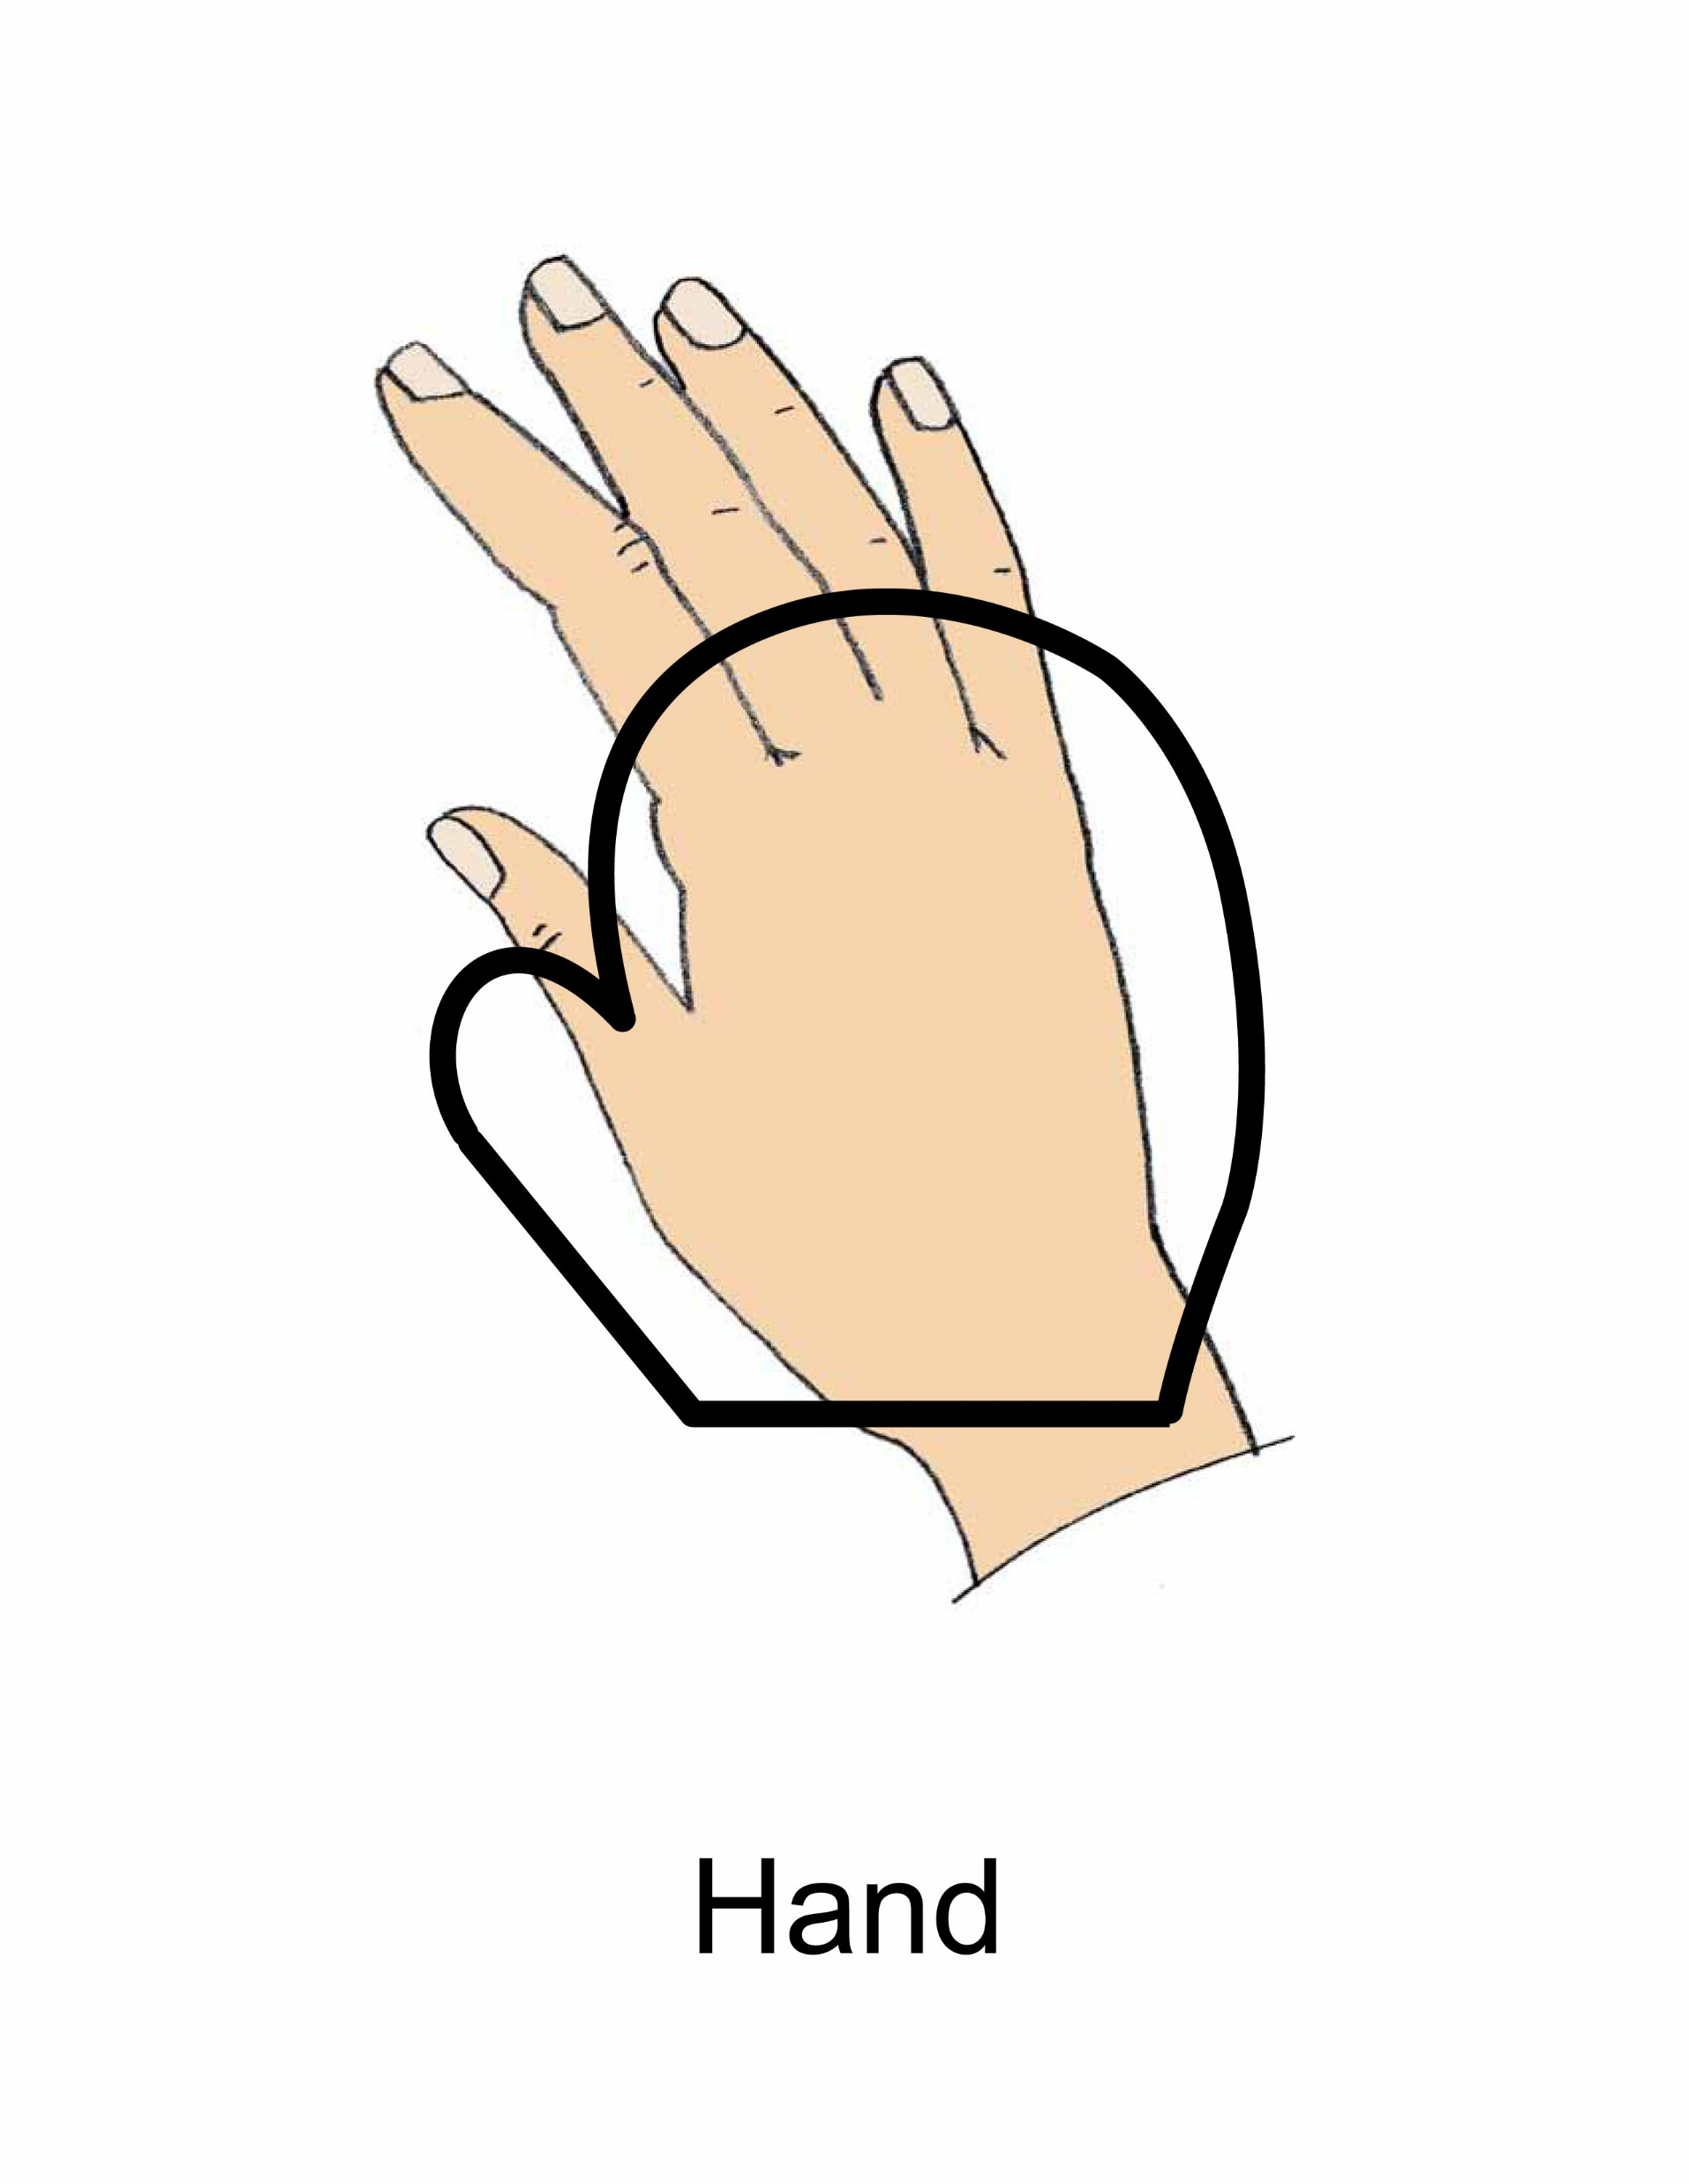

Hand

Slide 28

Notes:
A man walks to the house.

Slide 29

Notes:
A man drinks water.

Slide 30

Notes:
I see a man drinking water.

Slide 31

Notes:
I see water in a cup. I see a cup of water.

Slide 32

Notes:
A man sits by the window.

Slide 33

Notes:
I see a man walking to the door.

Slide 34
LESSON 3

Slide 35


No

Slide 36
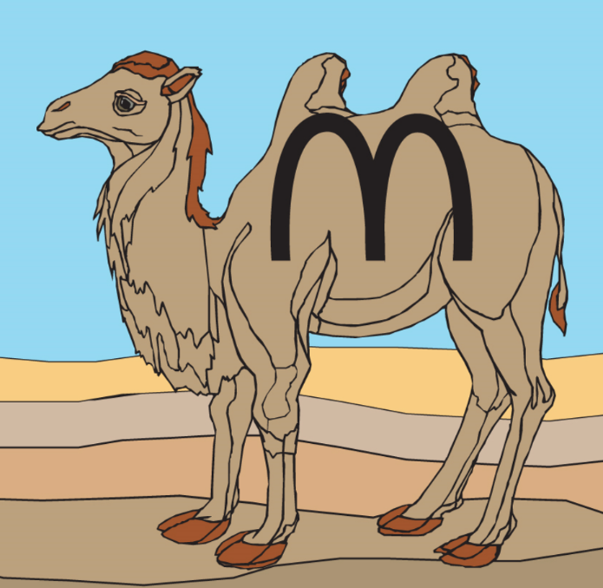
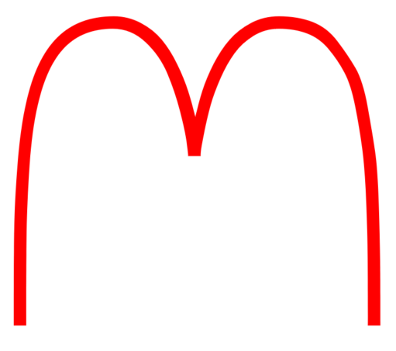
Camel

Slide 37
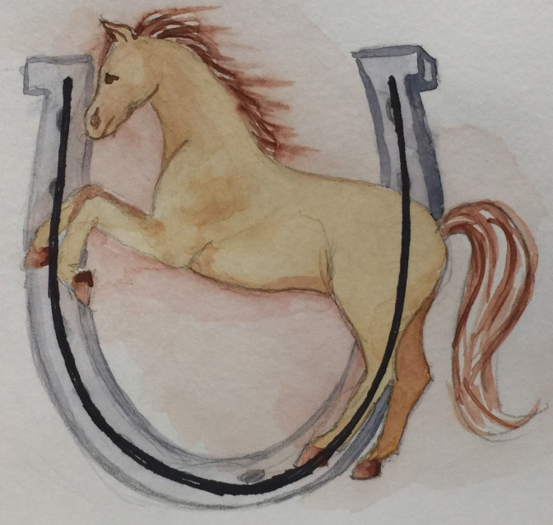

Horse

Slide 38


Good

Slide 39
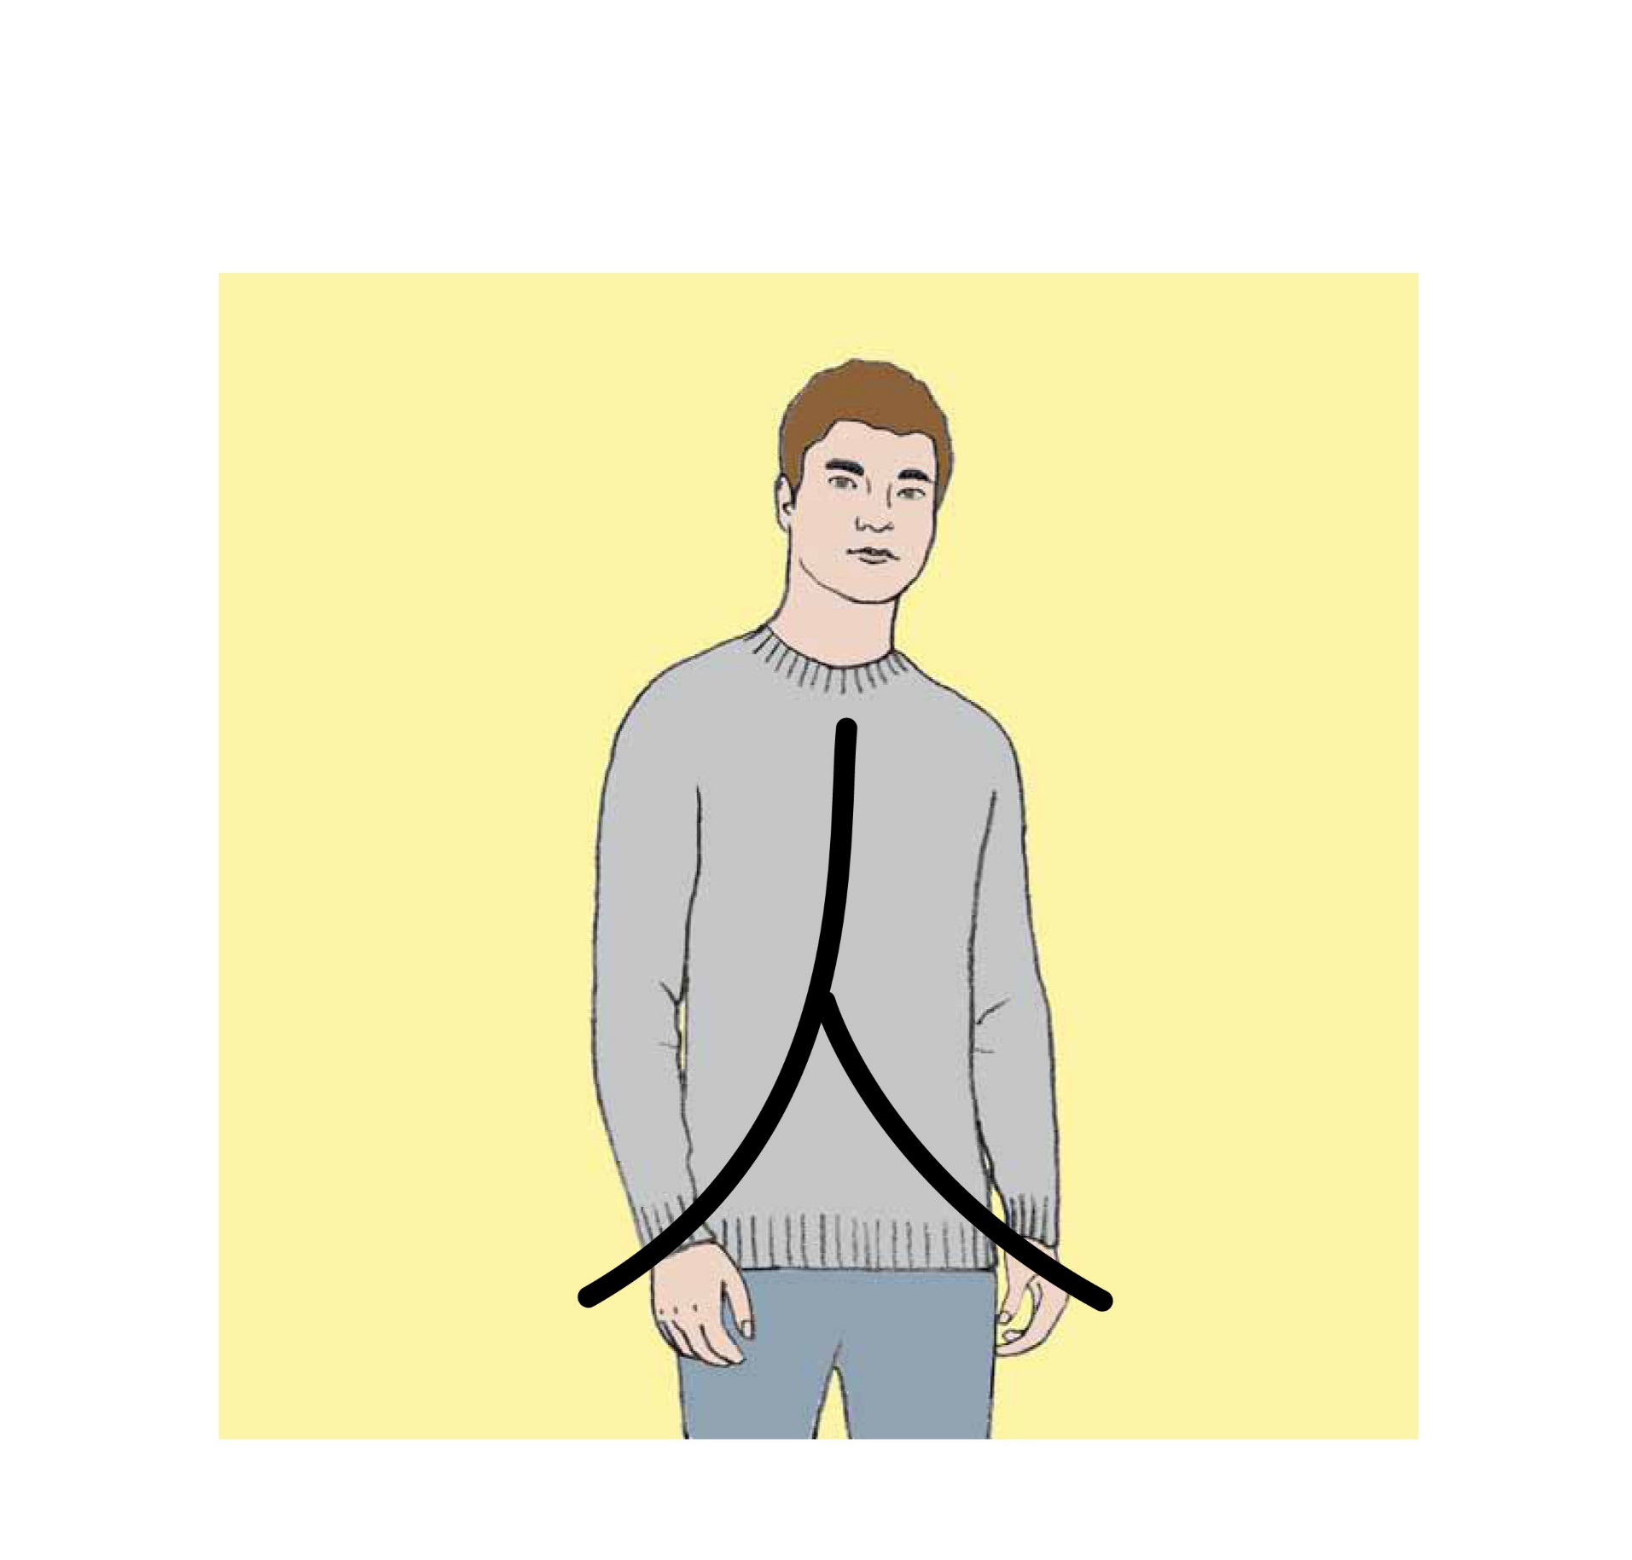
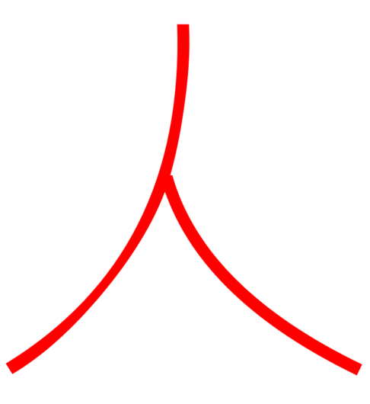
Person

Slide 40
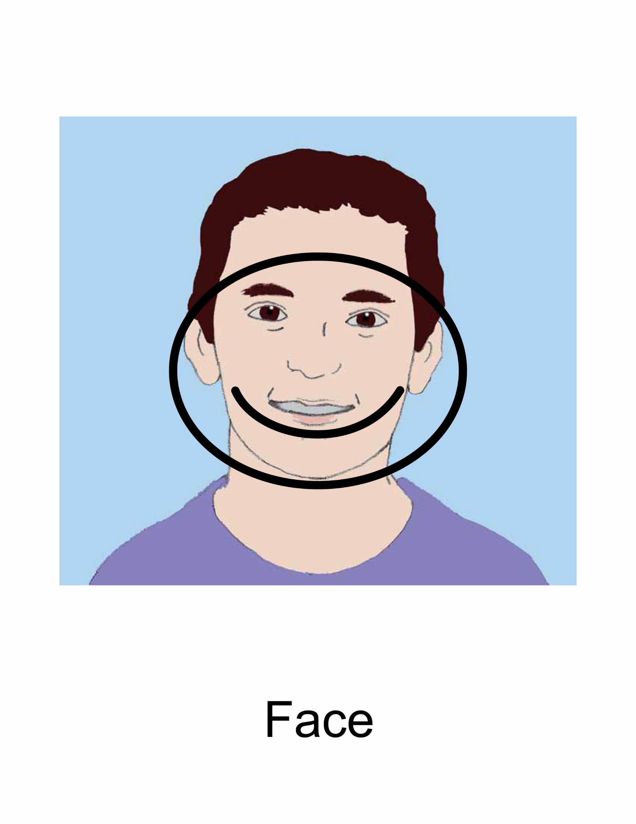

Face

Slide 41
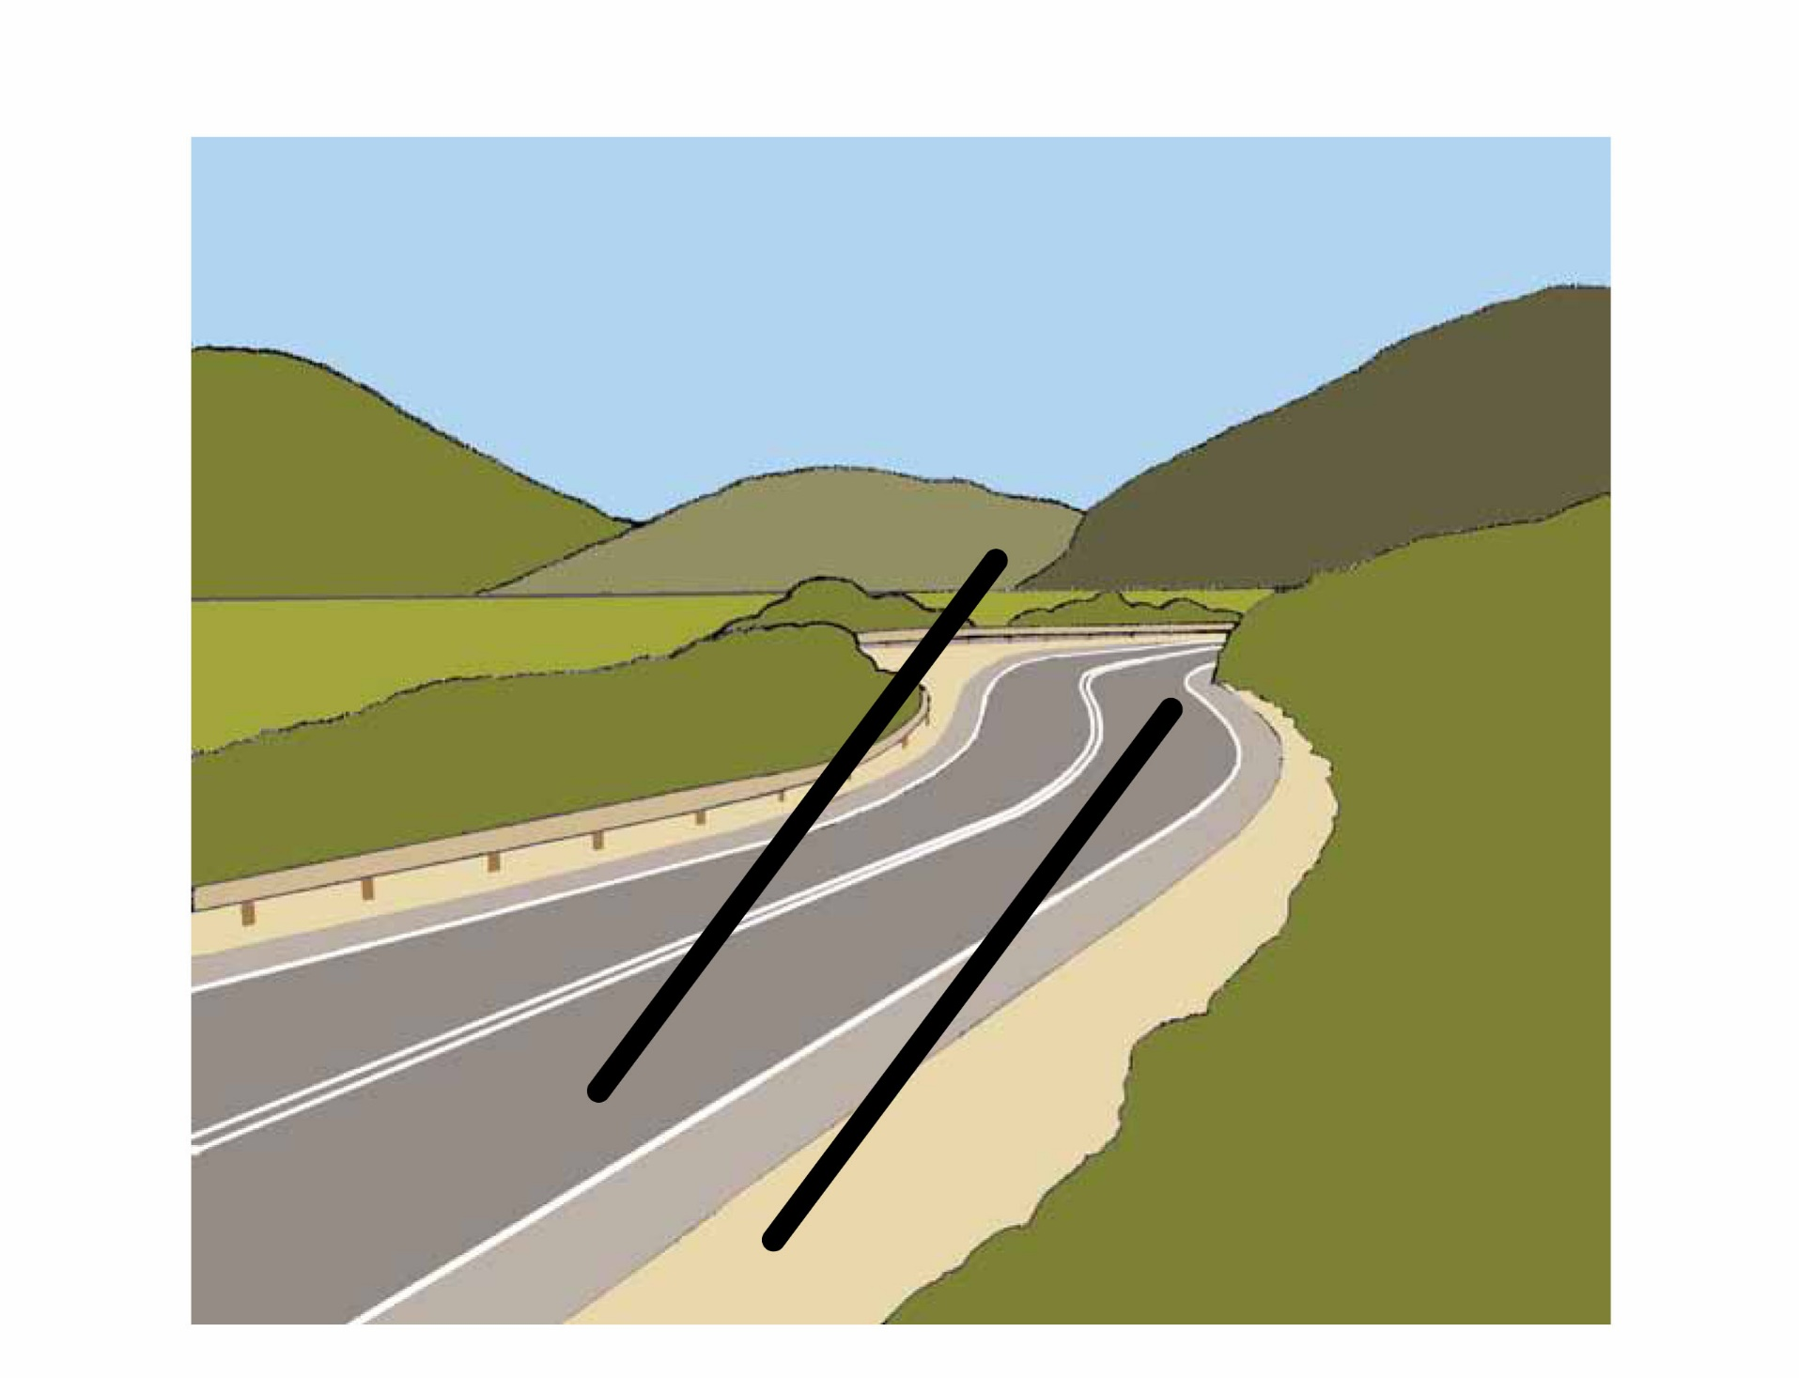

Road
Path
Way

Slide 42


Hole

Slide 43
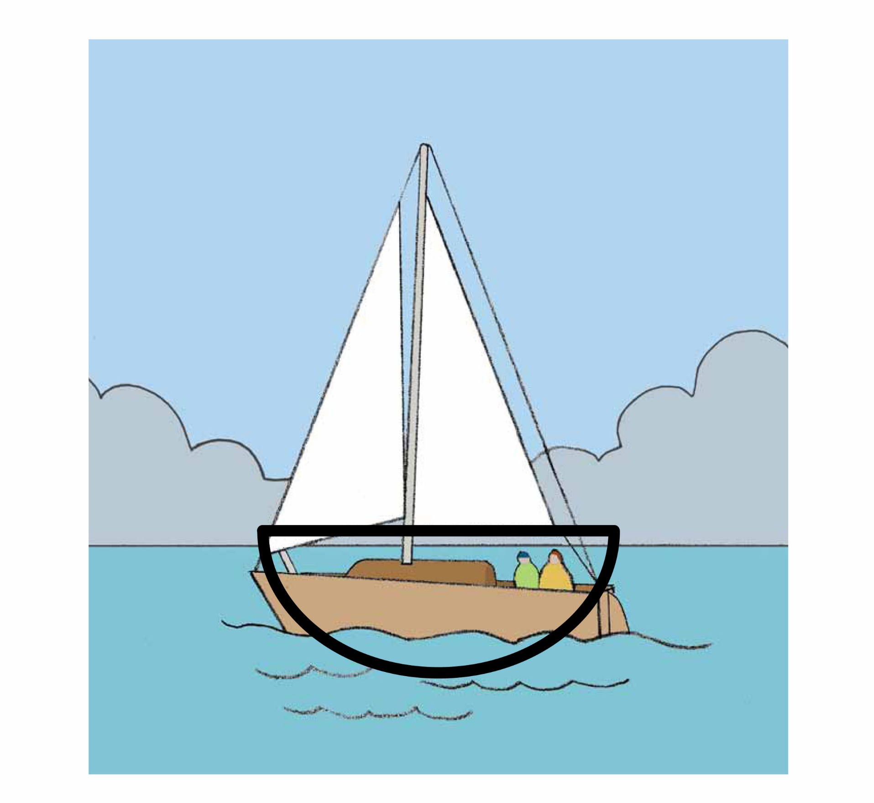
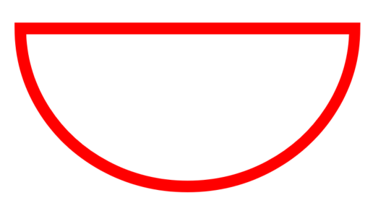
Boat

Slide 44
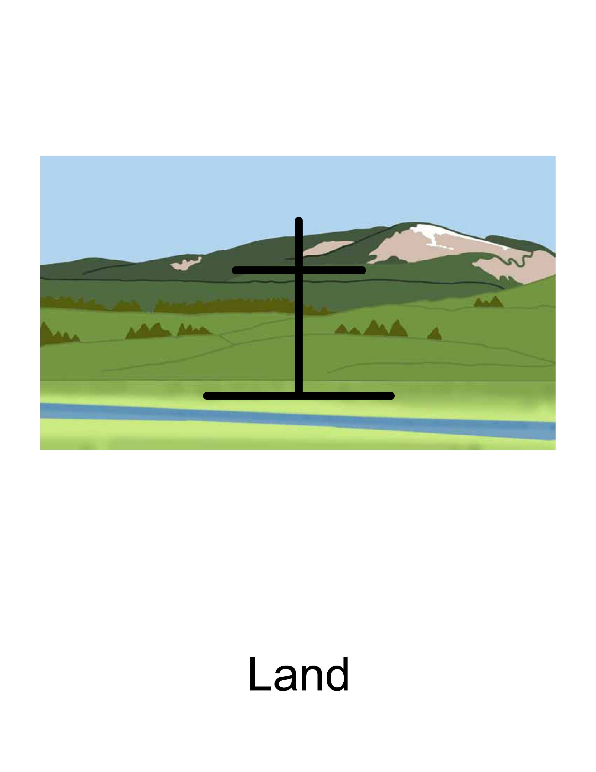

Land
Ground
Place
Space
Earth

Slide 45

Notes:
That person does not speak well.

Slide 46

Notes:
That person does not hear well.

Slide 47

Notes:
I see a person walking to the house.

Slide 48

Notes:
The tree does not smell good.

Slide 49

Notes:
My hands do the talking.

Slide 50

Notes:
A good person is speaking to me.

Slide 51
LESSON 4

Slide 52
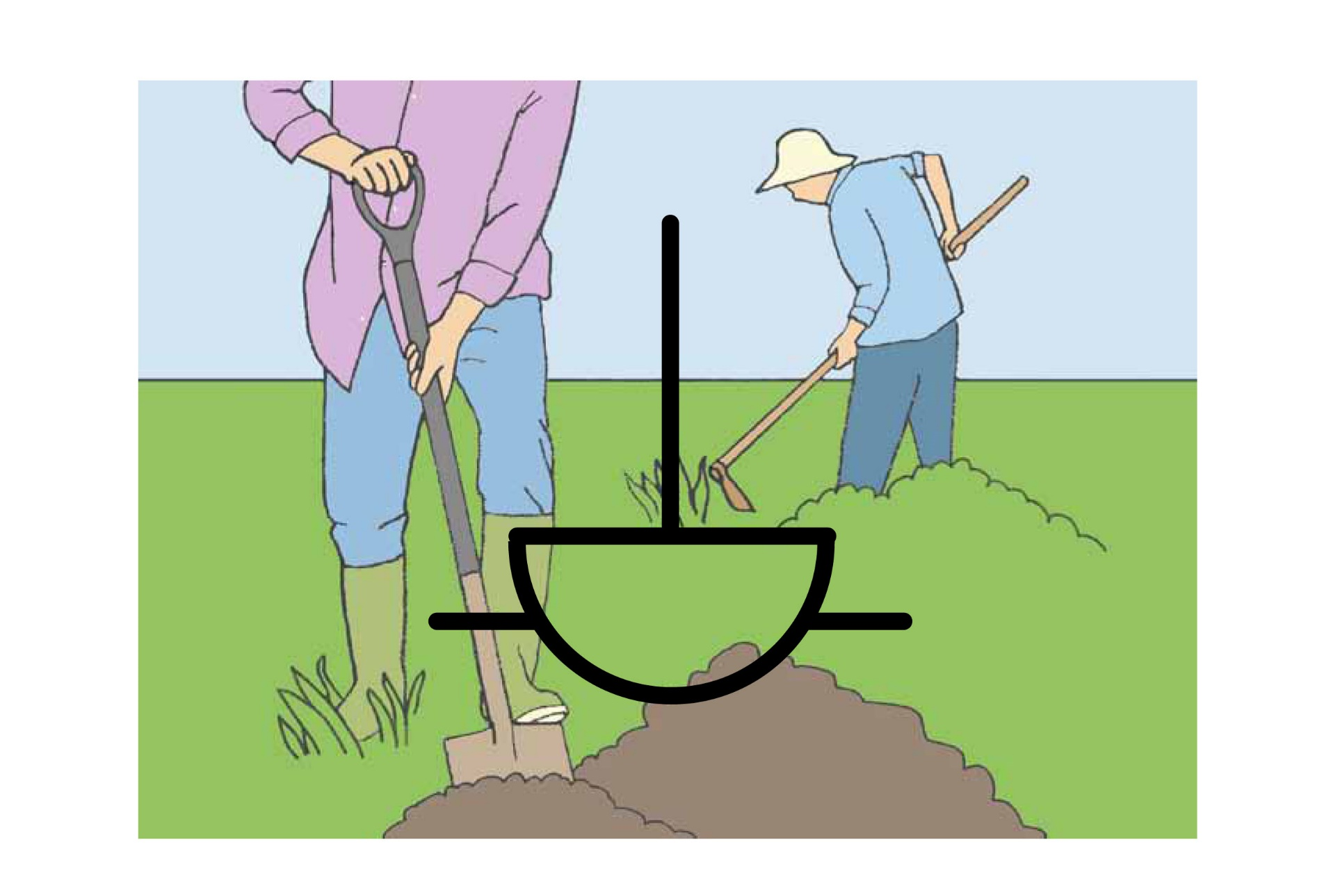
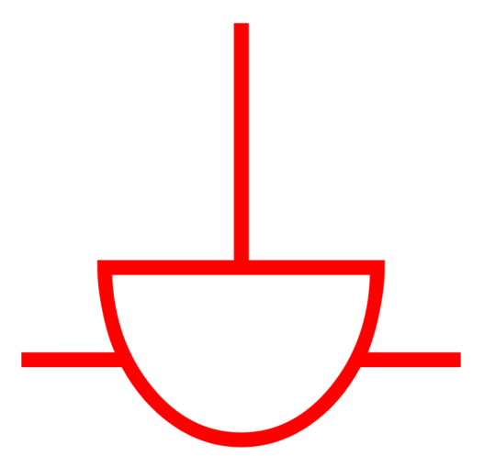
Work
Do

Slide 53
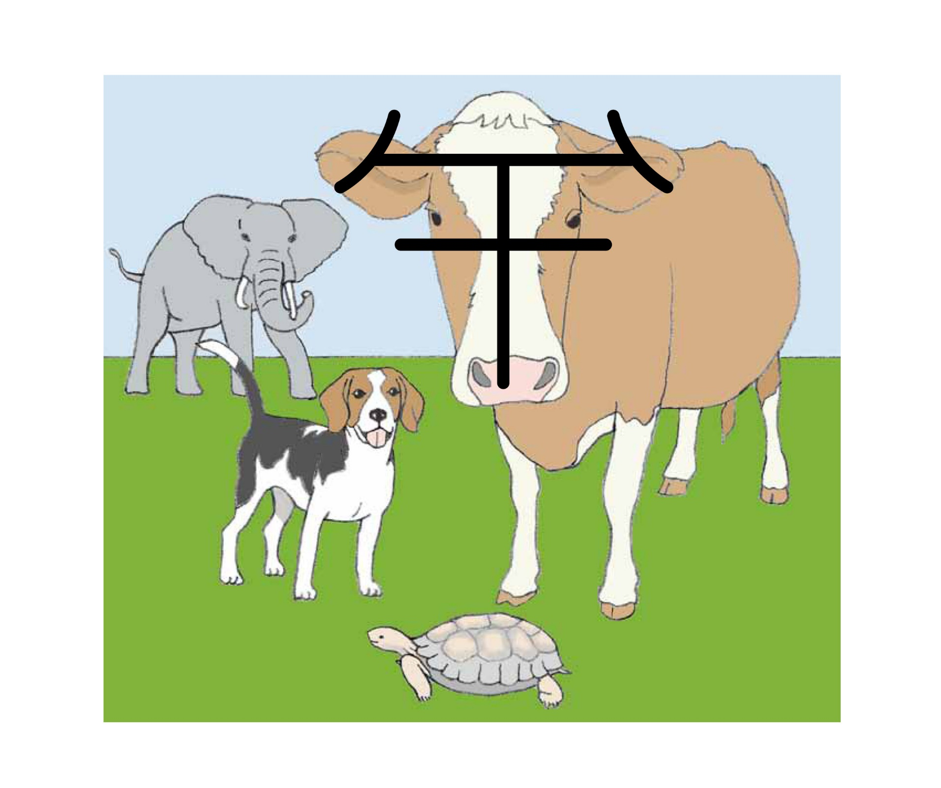
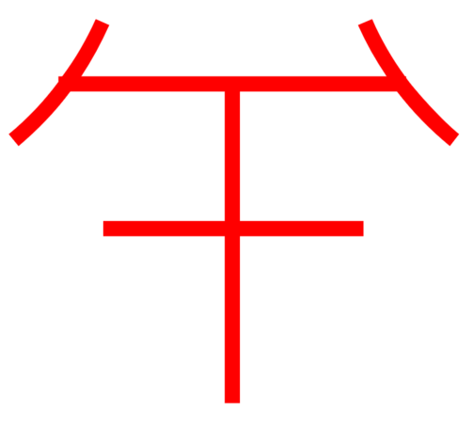
Animal

Slide 54
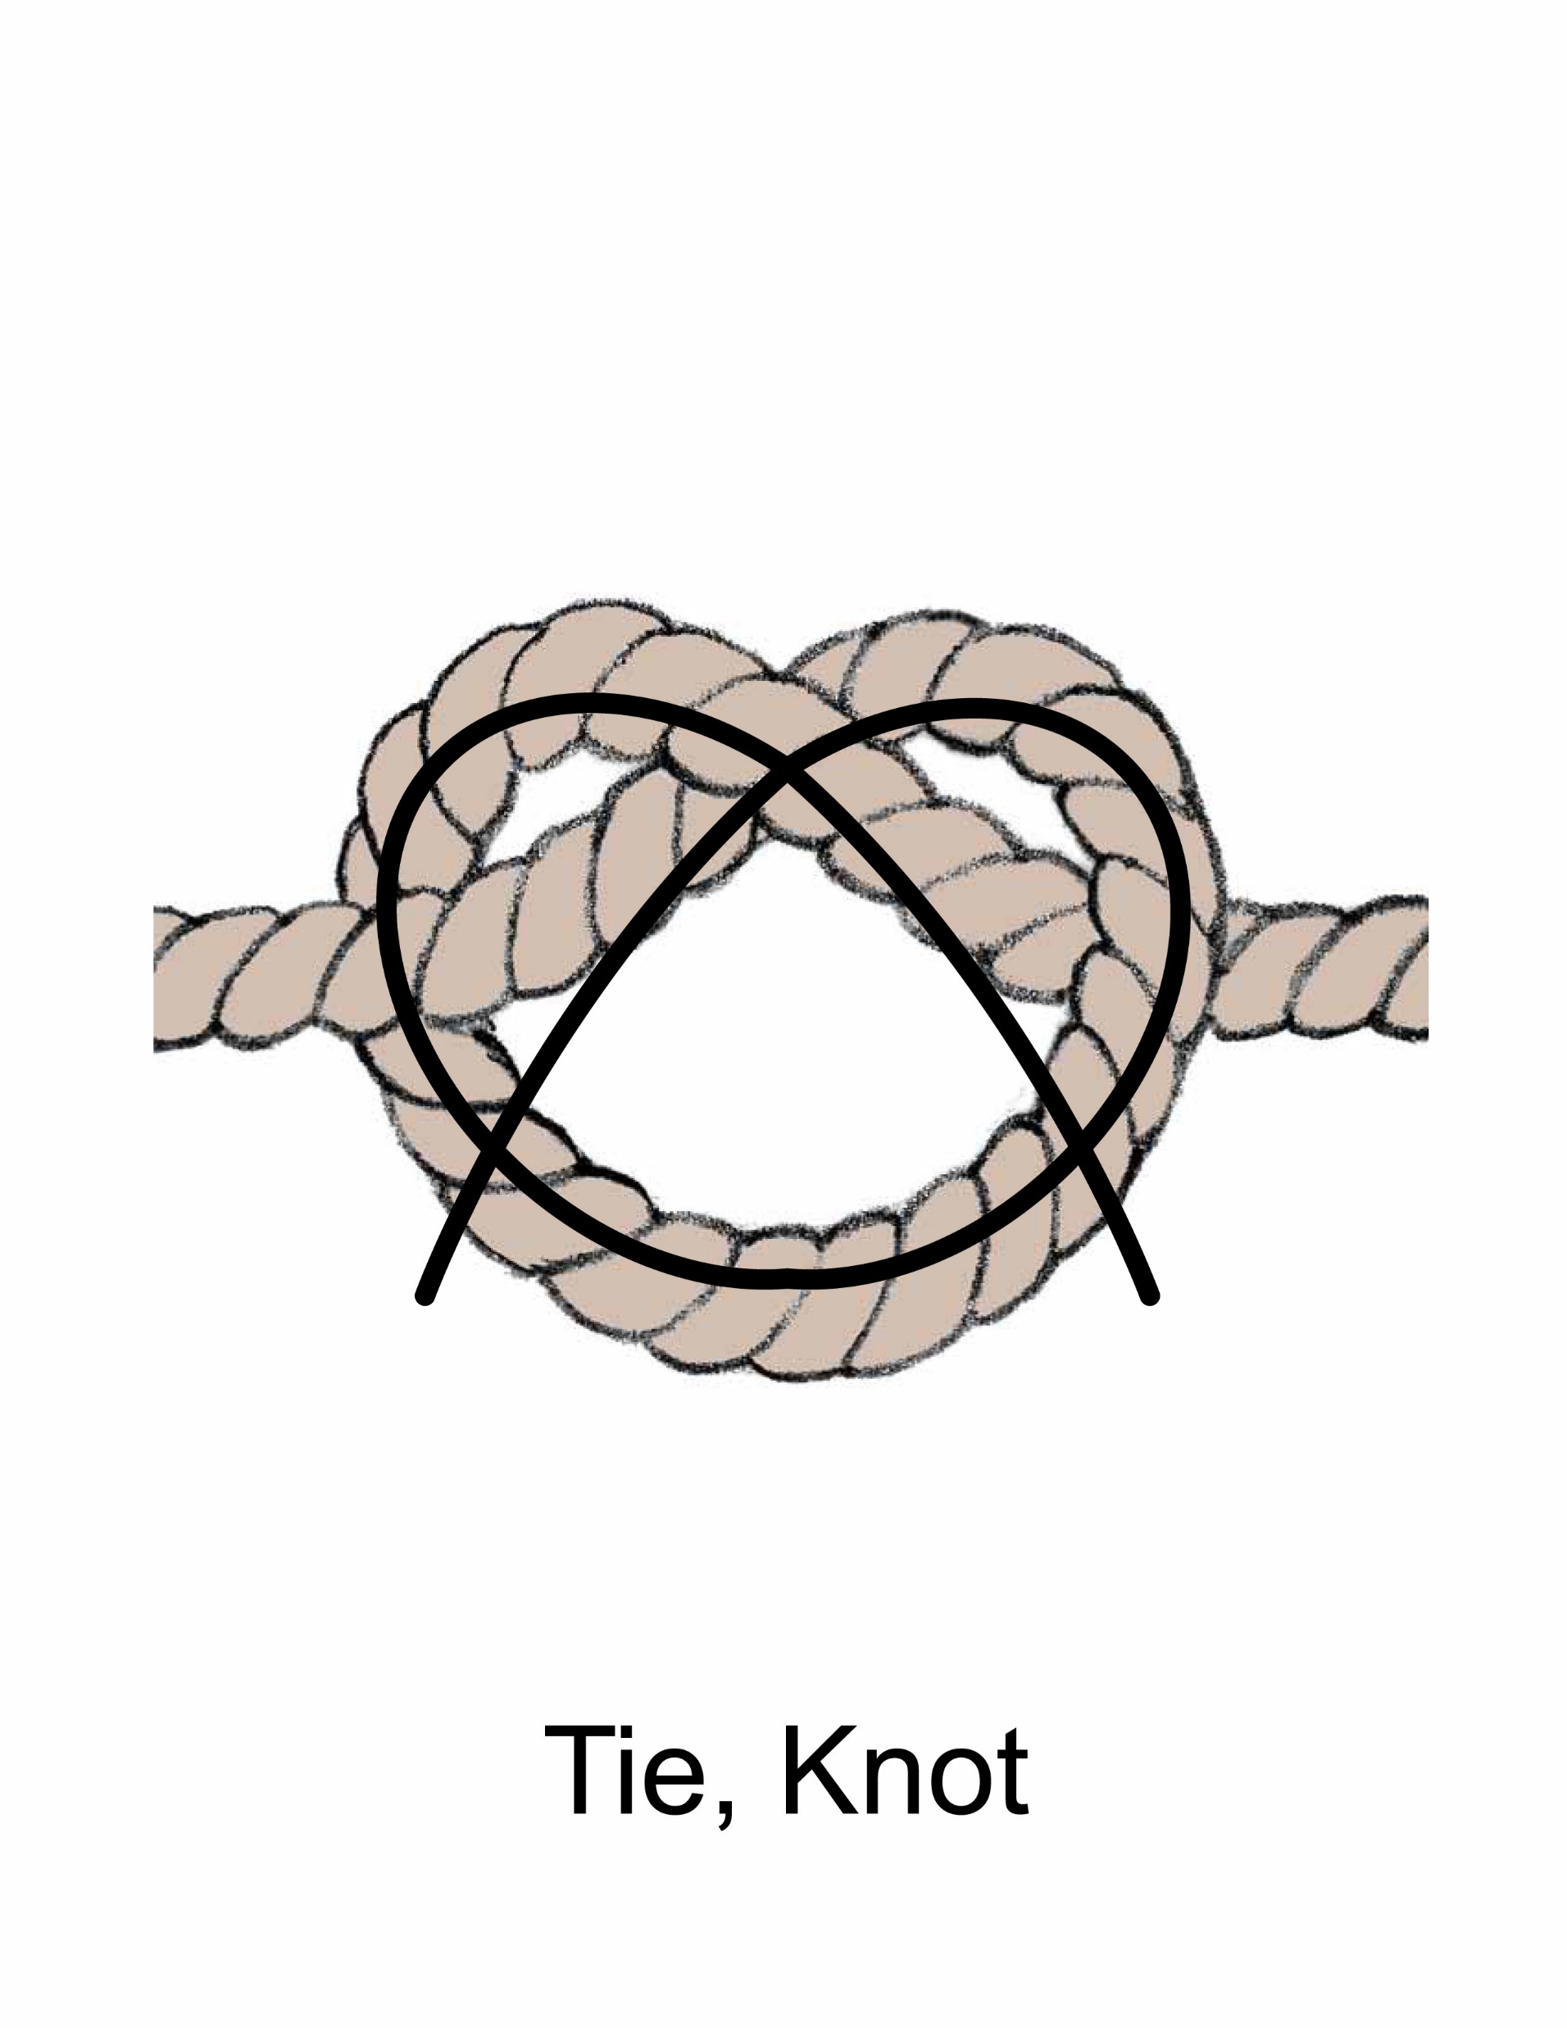
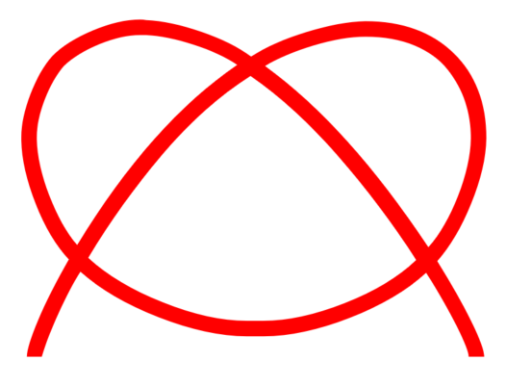
Tie
Knot

Slide 55
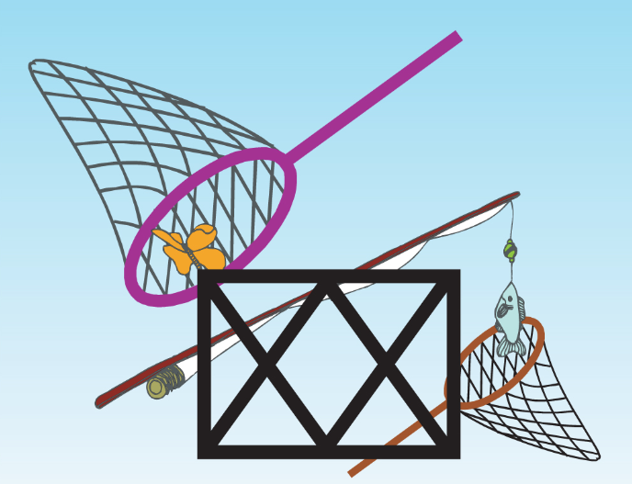

Net

Slide 56
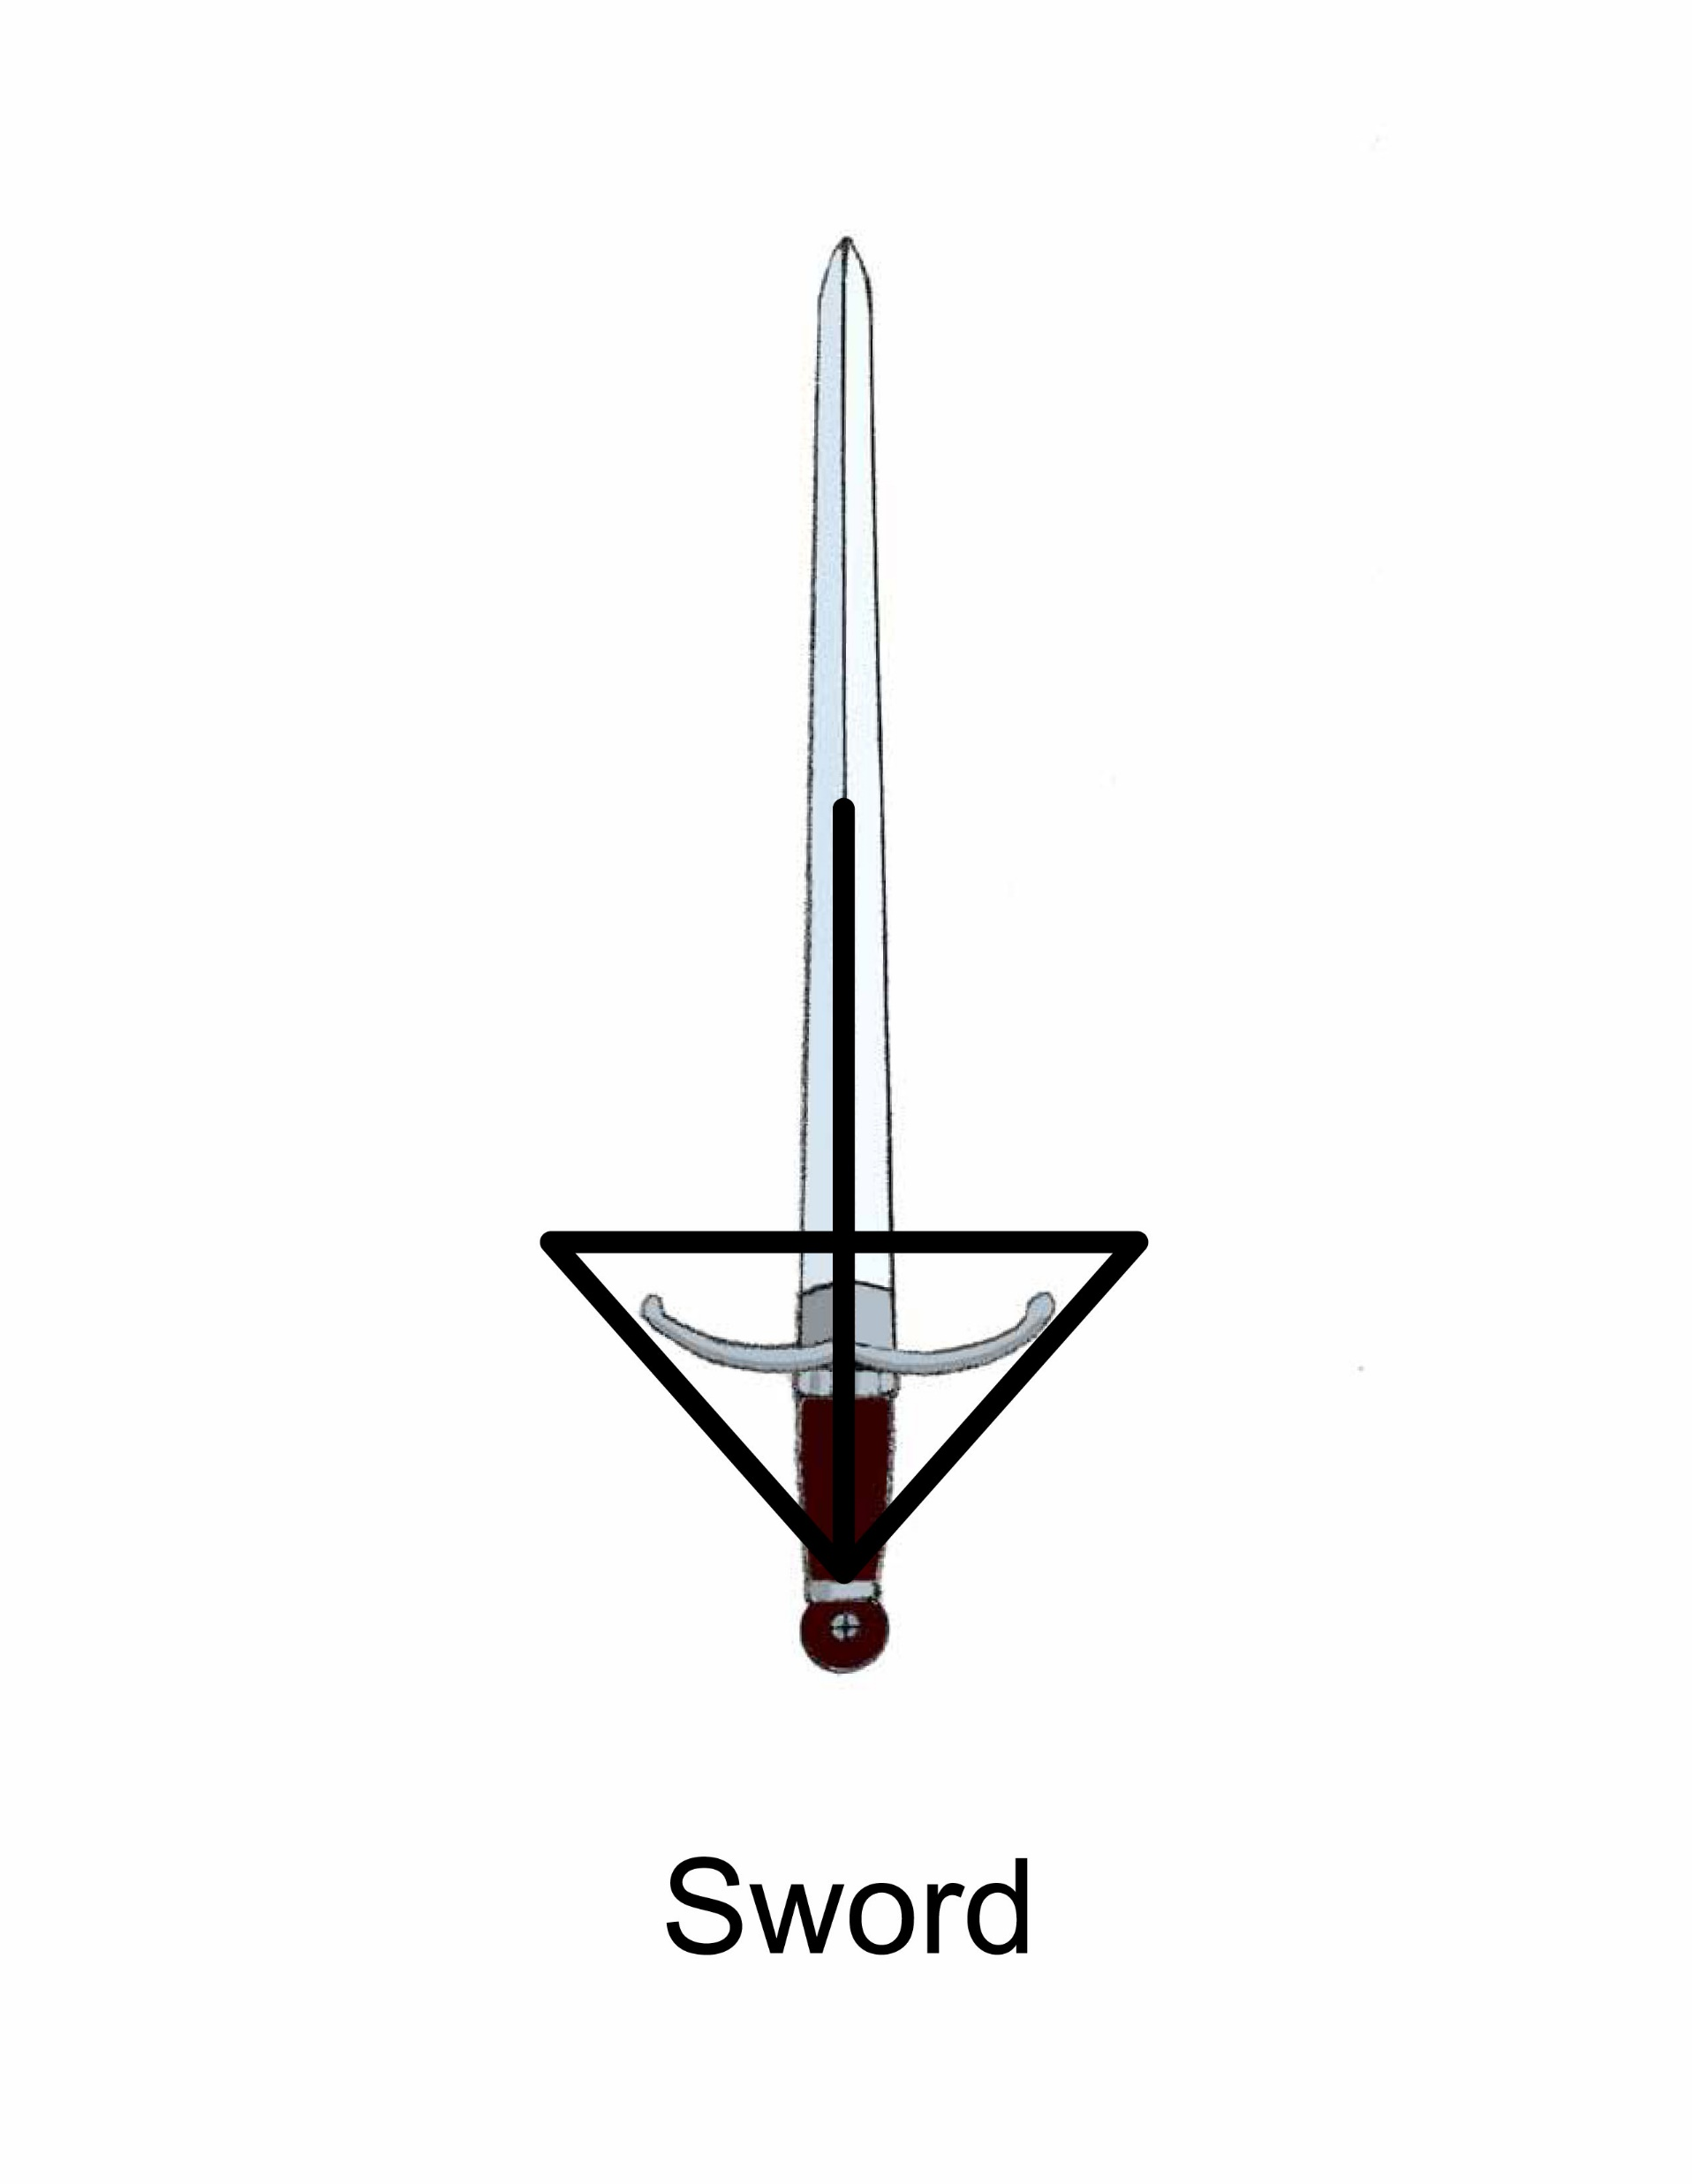

Sword

Slide 57
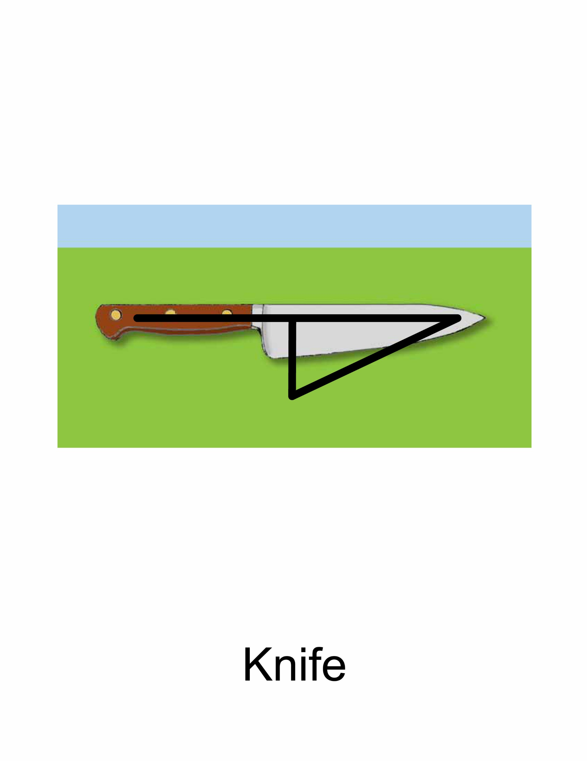
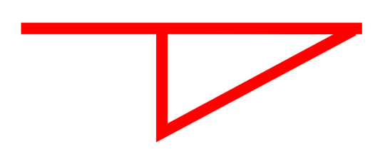
Knife
Cut

Slide 58
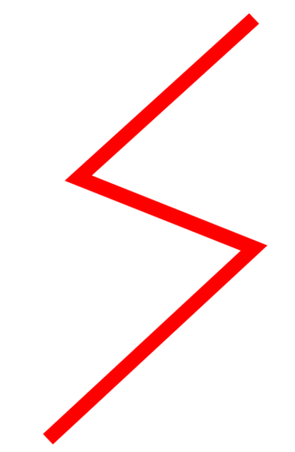
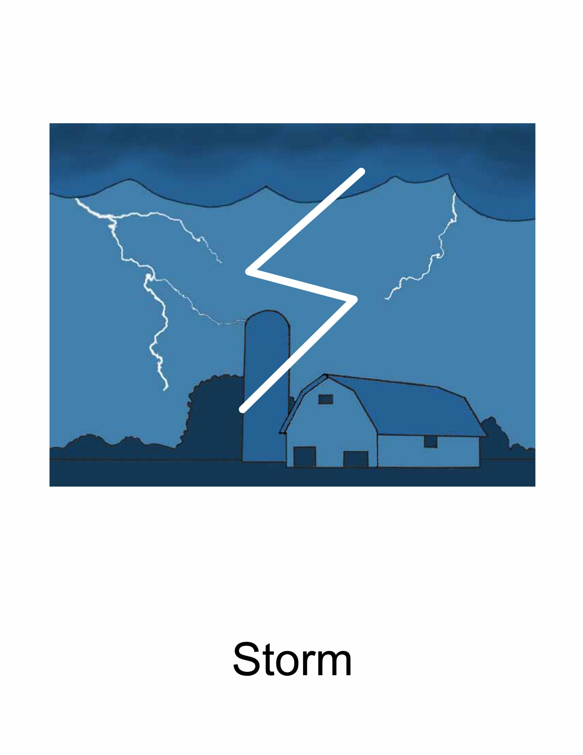
Storm

Slide 59
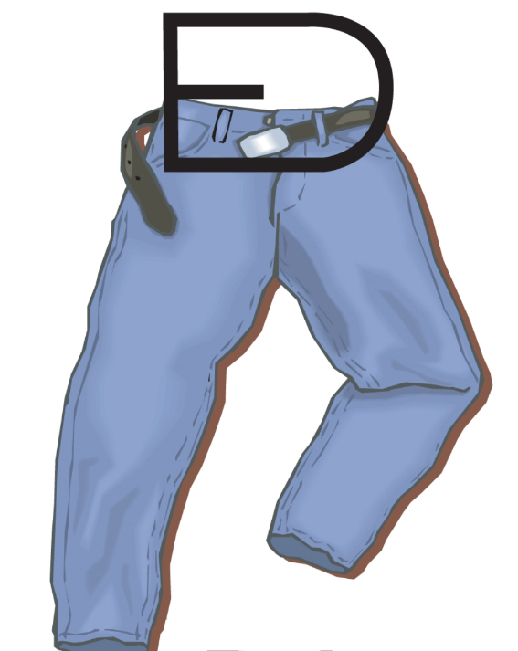

Belt

Slide 60

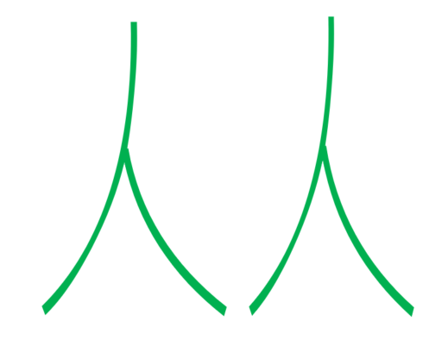
People
Two Persons
More than one person is people.

Slide 61
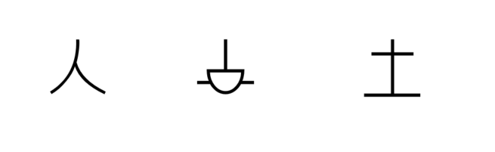
Notes:
That person works the land. That person is a farmer.

Slide 62

Notes:
I don’t see the boat in the storm.

Slide 63

Notes:
I walk the camel to the water.

Slide 64

Notes:
The house has a hole in the wall.

Slide 65

Notes:
I walk the road to the house.

Slide 66

Notes:
The horse cannot walk in the storm.

Slide 67
LESSON 5

Slide 68


Grain
Wheat

Slide 69


Pig

Slide 70


Fire
Hot

Slide 71


Fly

Slide 72


Fruit

Slide 73


Fish

Slide 74


Stream

Slide 75


Box

Slide 76


Chain
Bound
Arrest

Slide 77


Whip

Slide 78

Notes:
The sword cuts the net.

Slide 79

Notes:
A person whips the horse.

Slide 80

Notes:
I see a fruit tree.

Slide 81

Notes:
An animal is chained to the boat.

Slide 82

Notes:
I cut a hole in the box.

Slide 83

Notes:
The sun is hot.

Slide 84
LESSON 6

Slide 85


Small

Slide 86


Mountain

Slide 87


Book
Read
Learn

Slide 88


Heart

Slide 89


Woman
Man + (long hair)
Woman sometimes have long hair.

Slide 90


Many

Slide 91


Pen
Write

Slide 92


Snake

Slide 93


Clothing
Fabric

Slide 94


Hair
Little strands that grow from your head

Slide 95

Notes:
There are many small fish in the net.

Slide 96

Notes:
The animal works the grain field.

Slide 97

Notes:
I tie a belt on my clothes.

Slide 98

Notes:
Many animals are drinking at the river.

Slide 99

Notes:
The man has a good heart.

Slide 100

Notes:
A person ties clothing on a stick.

Slide 101
LESSON 7

Slide 102


Big
Person with arms stretched out.
When a person stretches his arms out wide, he is indicating something big.

Slide 103


Arm
Big + Arrow pointing at arm
The horizontal line on the word big indicates arms outstretched, so the word arm has an arrow pointing to the arm.

Slide 104


Salt
Mouth + Dot inside
The dot inside the mouth represents a grain of salt.

Slide 105


Bed
Lie down + (Line underneath)
The thing a person lies down on is a bed.

Slide 106


Happy
Joy
Smiling Face
A face that is smiling is happy.

Slide 107


Feet
Person + Arrow pointing at his feet.

Slide 108


Head
Face + Arrow pointing to the top of the face
The top of the face is the head.

Slide 109


Lay Down
Sleep
Rest
Person on his side
When a person is laying on his side, hi is sleeping or resting.

Slide 110


Name
I + Mouth
When you are telling someone who you are, you are telling him your name.

Slide 111

Notes:
The woman’s house is on the mountain.

Slide 112

Notes:
I write what the man says.

Slide 113

Notes:
Many small people sleep on a big bed.

Slide 114

Notes:
I read a good book.

Slide 115

Notes:
Salty fish is good.

Slide 116

Notes:
I did not see the hole in the road.

Slide 117
LESSON 8

Slide 118


Yes
Good + circle around it
When you are saying yes to something, you are saying that thing is good.

Slide 119


Thing

Slide 120


Greeting
Happy + Mouth
When you greet someone, you are telling them that you are happy to see them.

Slide 121


Sad
Grieve
Sad Face

Slide 122


Angry
Anger
Mad Face

Slide 123


Cry
Weep
Sad + Water
If you are sad and water comes down your face you are crying.

Slide 124


Boy
Small + Man
A small man is a boy.
.

Slide 125


Girl
Small + Woman
A small woman is a girl

Slide 126


Dog
Small + Animal
A dog is a small animal.

Slide 127


Food
Thing + Mouth
When there is a thing in your mouth, you are probably eating.

Slide 128

Notes:
The sad boy cries a lot.

Slide 129

Notes:
The man eats the pig.

Slide 130

Notes:
The dog is angry that there is no food.

Slide 131

Notes:
A person works for food.

Slide 132

Notes:
The woman says yes to the man.

Slide 133

Notes:
The angry boy cuts the snake with his sword.

Slide 134
LESSON 9

Slide 135

Waist
Person + Arrow pointing to the person’s waist

Slide 136

Plate
Platter
Big + Dish
A big dish is a plate or a platter.

Slide 137


Tongue
Mouth + Fabric
The fabric-like thing in your mouth is your tongue.

Slide 138


Spit
Mouth + Forward + Water
To spit is to throw out the water that comes from the mouth.

Slide 139


Thorn
Grain – (Leaf)
The grain symbol without the bottom leaf is a thorn.

Slide 140


Bread
Loaf
Grain + Mouth
The grain that you eat is often in the form of bread.

Slide 141


Basket
Small + Net
A Net is a big woven thing that holds objects. A basket is a small woven thing that holds objects.

Slide 142


Bird
Fly + (dot)
The dot indicates the thing that is flying which in this case is a bird.

Slide 143


Seed
Small + Grain
A seed is a grain in its smallest form.
.

Slide 144

Notes:
When I eat fruit, I spit out the seed.

Slide 145

Notes:
The bird eats the bread in the basket.

Slide 146

Notes:
The man greets me by saying his name.

Slide 147

Notes:
The man is angry that a thorn cut his hand.

Slide 148

Notes:
My tongue speaks good things.

Slide 149

Notes:
That man has a small waist.

Slide 150
LESSON 10

Slide 151


Perfume
Fragrance
Fragrant
Good + Nose
When something is good to your nose, it is because it is fragrant.

Slide 152


Sea
Ocean
Big + Water
A big body of water is a sea or ocean.

Slide 153


Insect

Slide 154


Dry
No + Water
When there is no water, it is dry.

Slide 155


Hill
Small + Mountain
A hill is a small mountain.

Slide 156


Bow
Face + Down
When you bow, your face goes down towards the ground.

Slide 157


Branch
Tree with an arrow pointing to the branch

Slide 158


Curtain
Drapes
Window + Fabric
The fabric on a window is called a curtain.

Slide 159


Rooster
Bird + Day
A rooster is a bird who crows to start the day.

Slide 160

Notes:
The woman’s perfume smells good.

Slide 161

Notes:
That tree has many small branches.

Slide 162

Notes:
The dry land has no water.

Slide 163

Notes:
Many insects walk on the hill.

Slide 164

Notes:
The window has a big curtain.

Slide 165

Notes:
There is a small boat in the big ocean.

